Slide 1
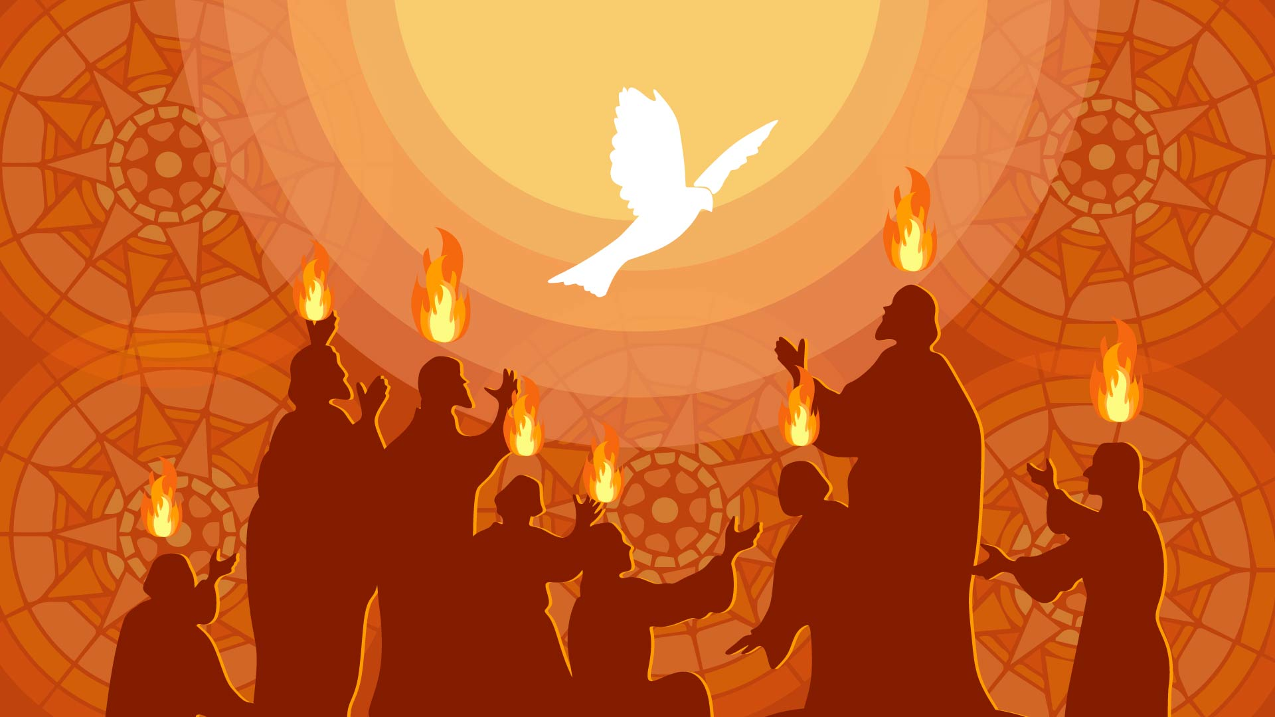
Drawn by the Spirit

Slide 2
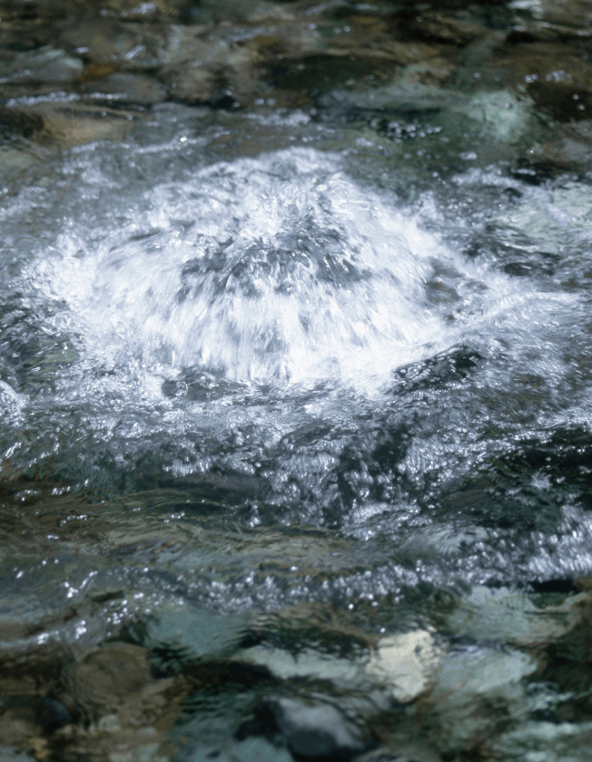
‘On the last and most important day of the festival, Jesus stood up and cried out “If anyone is thirsty, let him come to me and drink. The one who believes in me, as the Scripture has said, will have streams of living water flow from deep within him.” He said this about the Spirit. Those who believed in Jesus were going to receive the Spirit, for the Spirit had not yet been given because Jesus had not yet been glorified.’

Slide 3

Question:
What does it mean that the Spirit had not yet been given?

Slide 4
Question:
What does it mean that the Spirit had not yet been given?
A: ‘Because Jesus had not yet been glorified.’

Slide 5
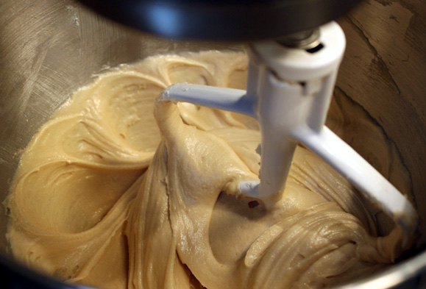
What is the Spirit waiting for?

Slide 6
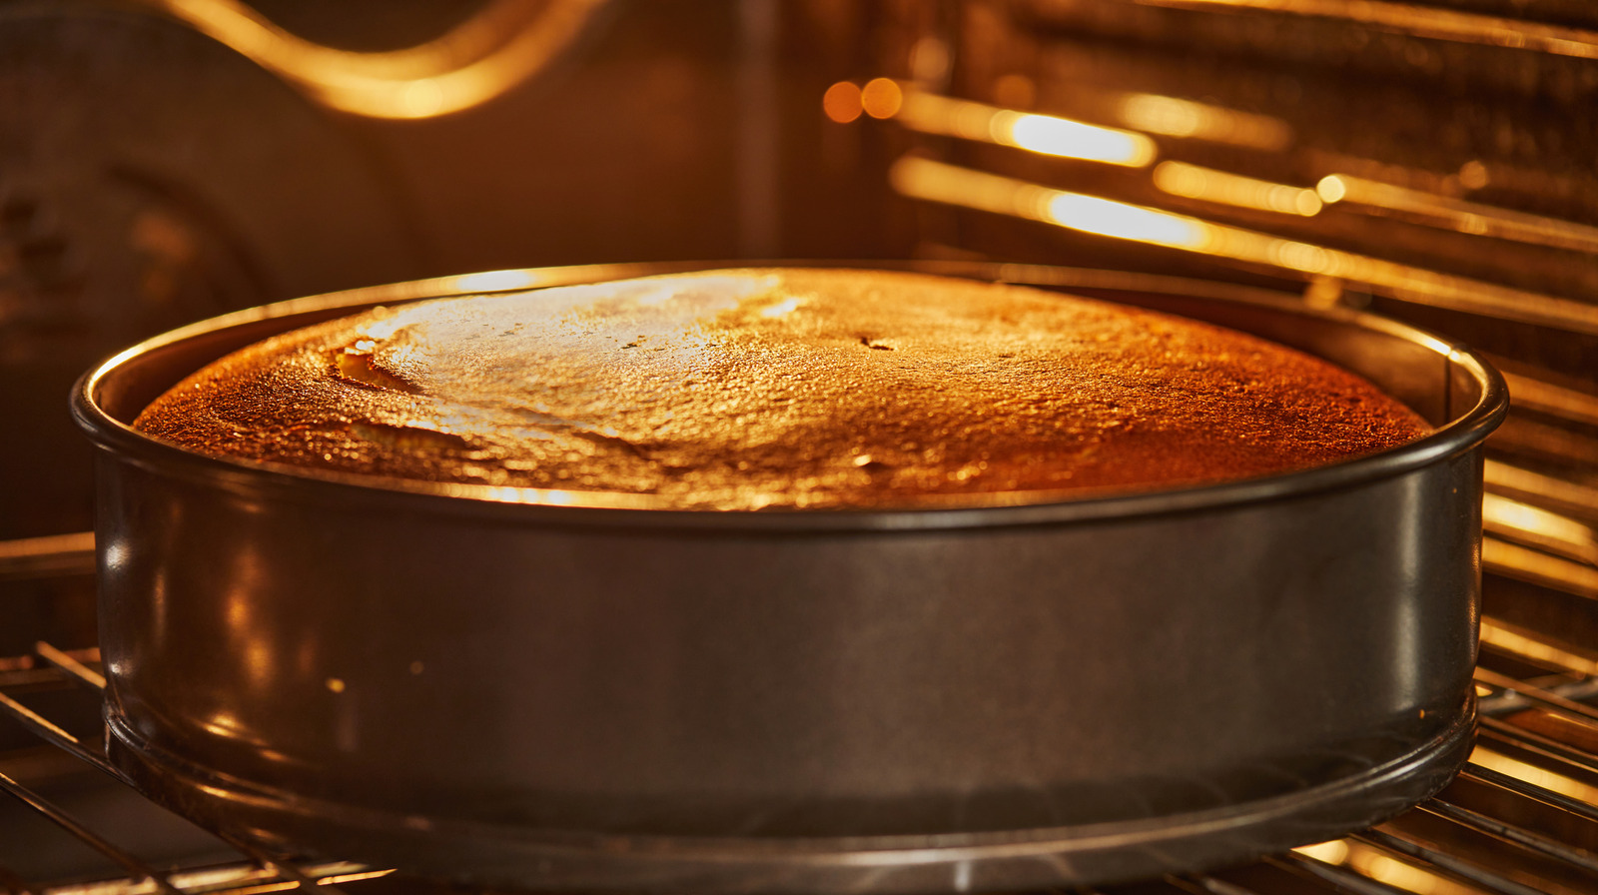

Slide 7
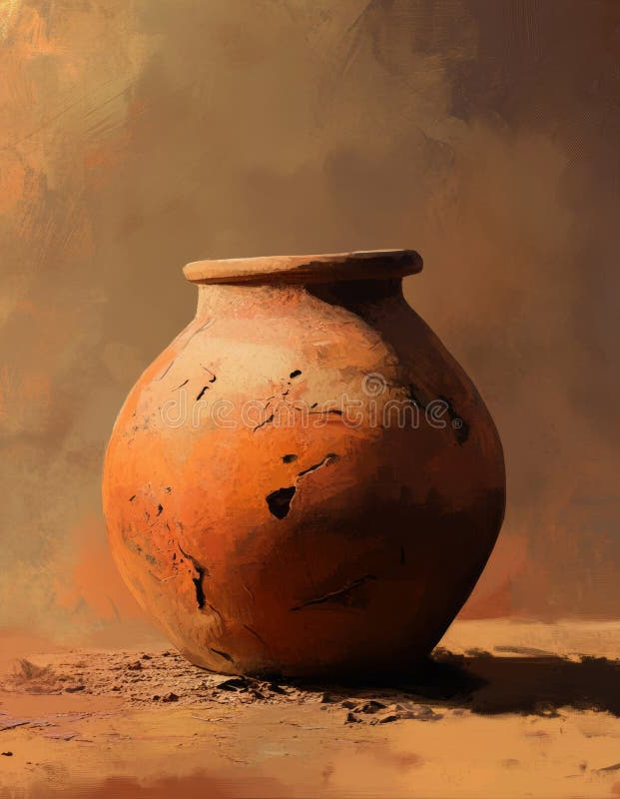
“For we are not proclaiming ourselves but Jesus Christ as Lord, and ourselves as your servants for Jesus’s sake. For God who said, “Let light shine out of darkness,” has shone in our hearts to give the light of the knowledge of God’s glory in the face of Jesus Christ.
"Now we have this treasure in clay jars, so that this extraordinary power may be from God and not from us.

Slide 8
"We are afflicted in every way but not crushed; we are perplexed but not in despair; we are persecuted but not abandoned; we are struck down but not destroyed. We always carry the death of Jesus in our body, so that the life of Jesus may also be displayed in our body. For we who live are always being given over to death for Jesus’s sake, so that Jesus’s life may also be displayed in our mortal flesh.

Slide 9
"Therefore we do not give up. Even though our outer person is being destroyed, our inner person is being renewed day by day. For our momentary light affliction is producing for us an absolutely incomparable eternal weight of glory. So we do not focus on what is seen, but on what is unseen. For what is seen is temporary, but what is unseen is eternal.”

Slide 10
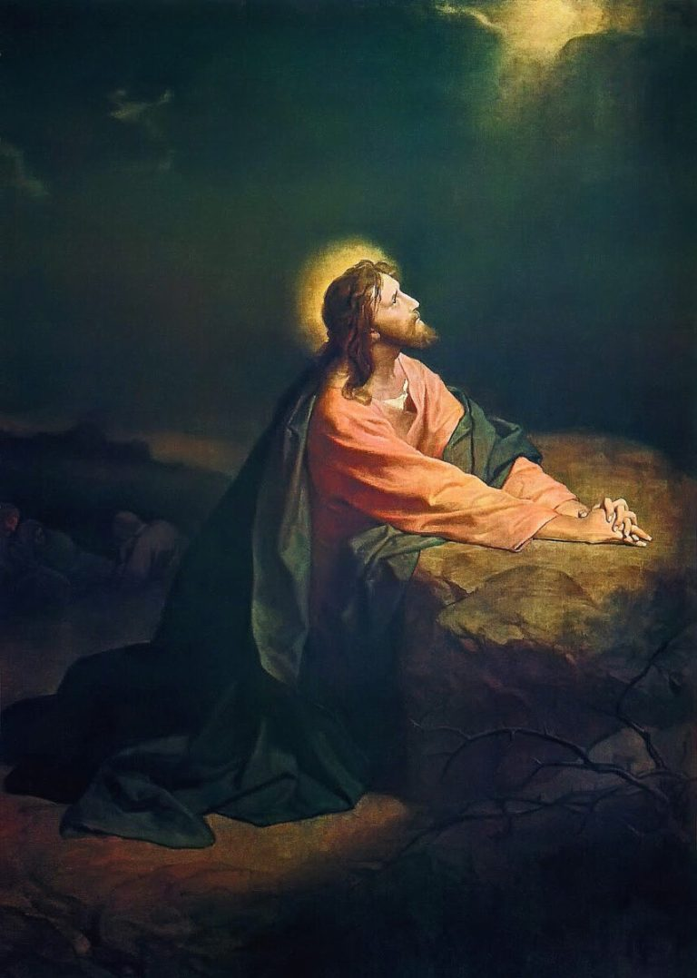
To be filled with Christ's Spirit...

Slide 11
Pentecost prayer
Come, Holy Spirit. Burn away what is false, refine what is real, and form in us the likeness of the Son. Teach us to see our trials as your workshop, our weakness as your canvas, our endurance as your miracle.
May we be Pentecostal not only in power but in perseverance — not only in signs and wonders but in steadfast love.
Come, Spirit of the glorified Christ. Transform us.

