Slide 1

Where it all began
Genesis 1, 2

Slide 2
What's the problem?

Slide 3
What's the problem?
What is the question to which 'discipleship' is the answer?

Slide 4
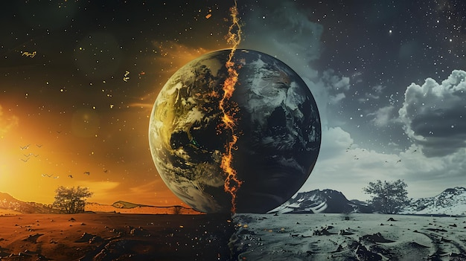
Genesis 1:2-9: God separates

Slide 5
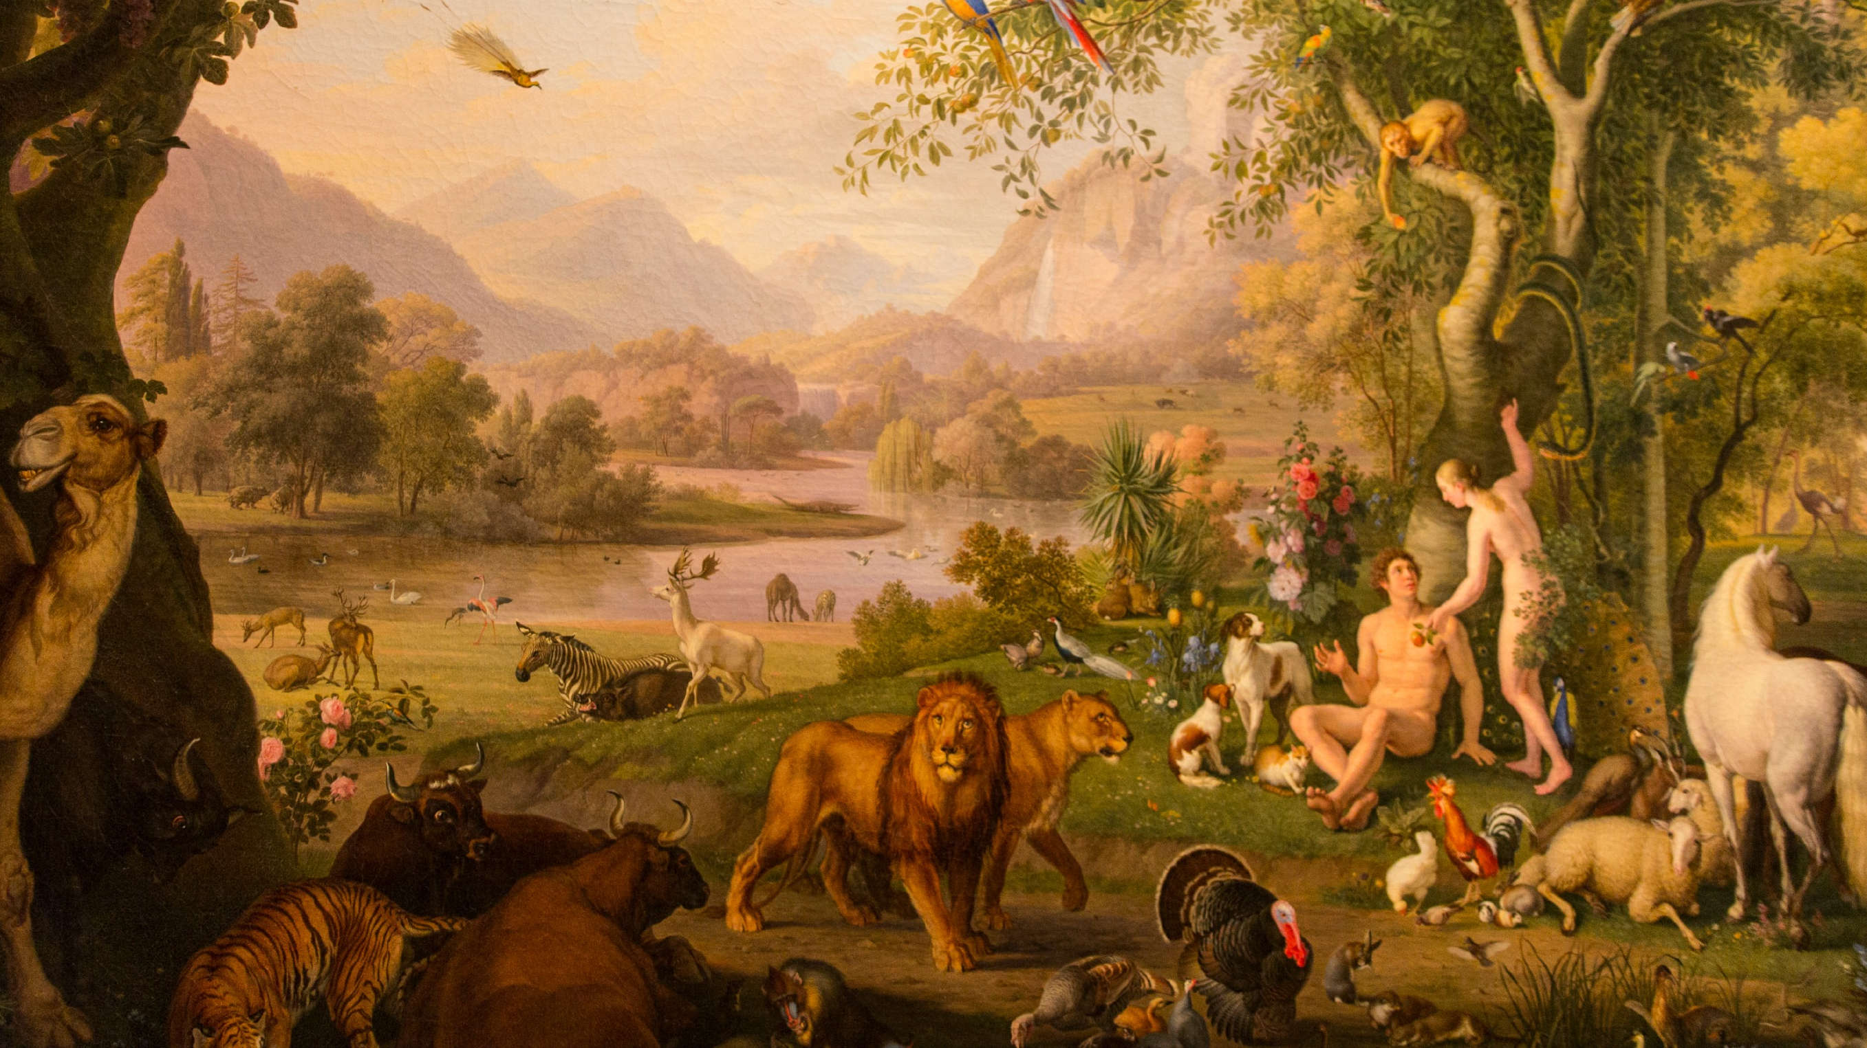
Genesis 1:9-27: God fills

Slide 6
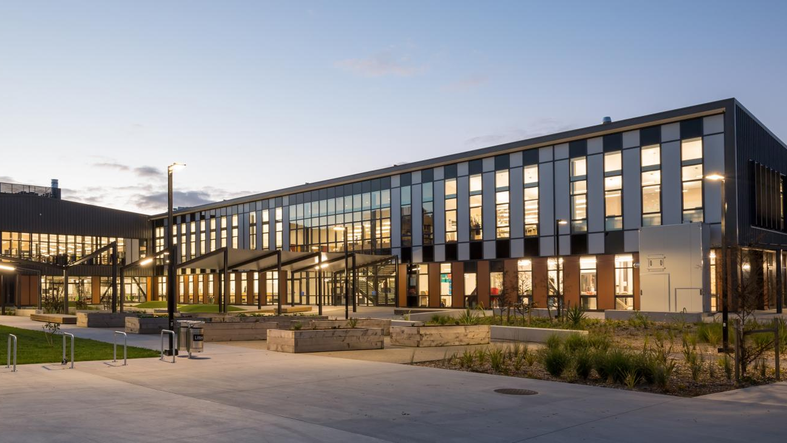
Is this a school?

Slide 7
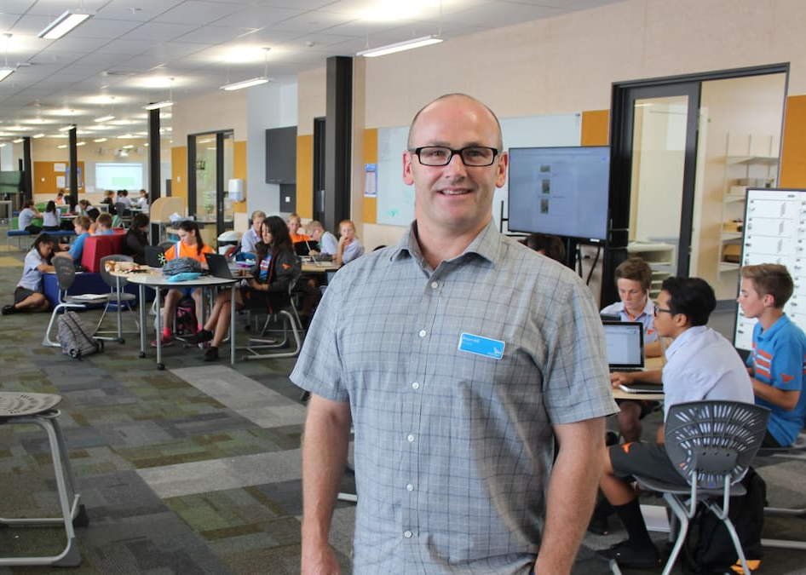
Or is THIS a school?

Slide 8
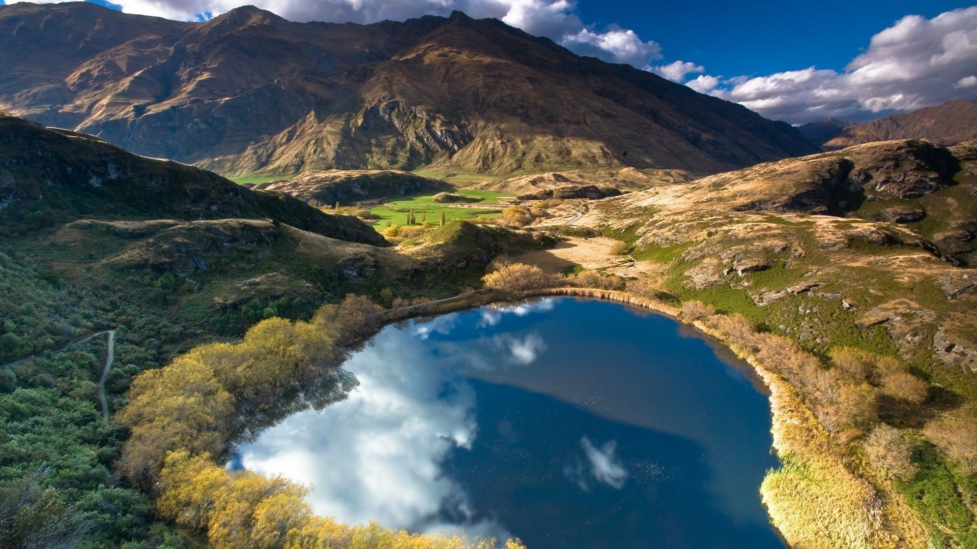
It is good!

Slide 9
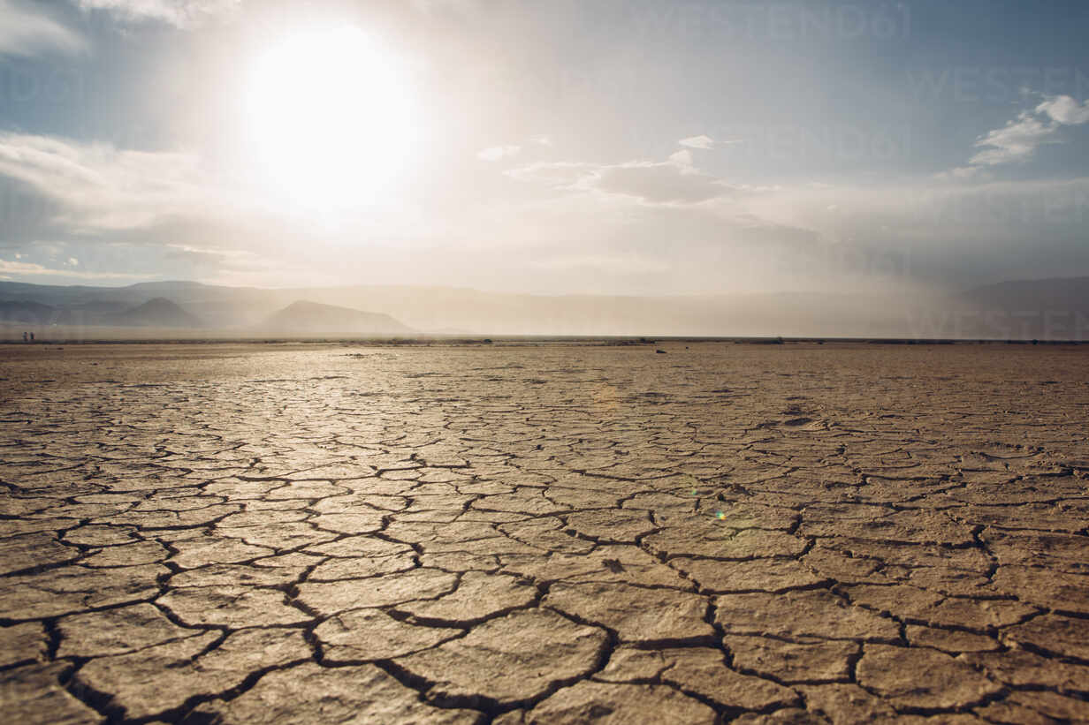
Genesis 2: another perspective
“At the time that the Lord God made the earth and the heavens, no shrub of the field had yet grown on the land and no plant of the field had yet sprouted, for the Lord God had not made it rain on the land, and there was no man to work the ground.”

Slide 10

Genesis 2:
It is NOT good...
“It is not good for earthling to be alone.”

Slide 11

At last!

Slide 12
Conclusion:
God created out of desire, not need
Creation is necessarily orderly
Creation reflects God's passion
We finite beings with infinite longings might face challenges...

