Slide 1

The reason for church

Slide 2
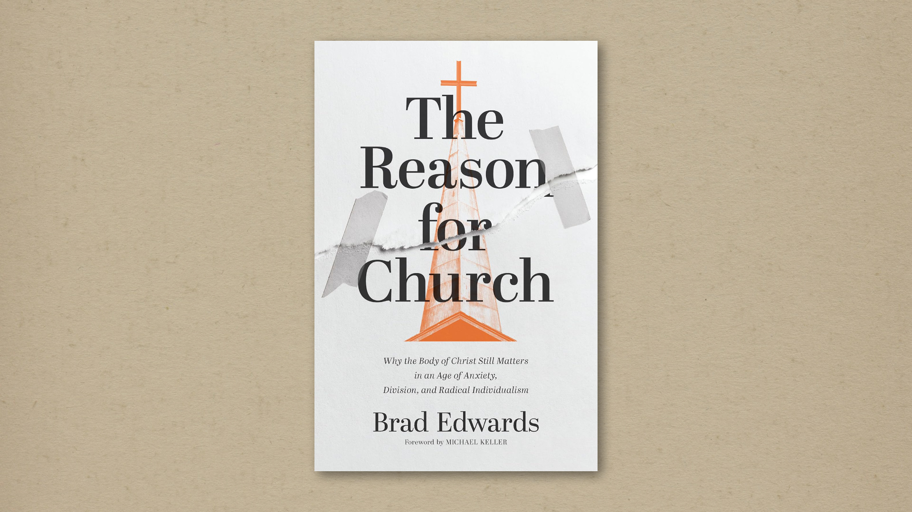

Slide 3
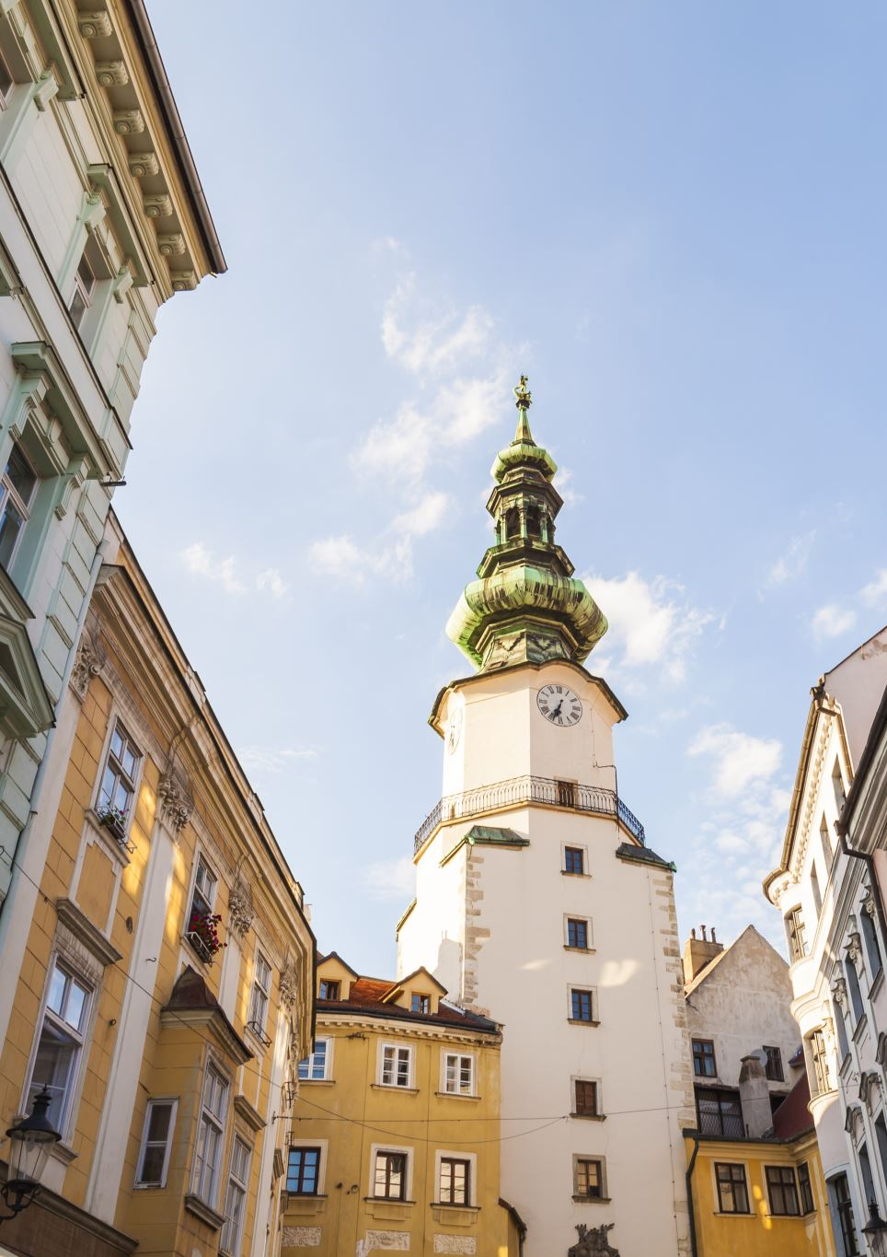
1. Spiritual pragmatism
Churches exist for my personal spiritual growth and help me fulfil my unique potential.
Therefore, to follow Jesus faithfully may require leaving or switching churches for one that better meets my spiritual needs.

Slide 4
Spiritual pragmatism
“At the end of the day, spiritual pragmatism stunts our growth because the church is not a transactional organization but is rather—like any other family—a formative institution. Spiritual pragmatism can’t help but undermine our experience of God’s love and our belonging to him because how we relate to church and how we relate to God are indelibly linked. That’s how God made us.”

Slide 5
Spiritual pragmatism
“Over time, treating the church lightly in the name of taking our faith seriously will inevitably weaken our attachment to church and, therefore, to the ordinary means of experiencing the love and belonging for which we are “fearfully and wonderfully made” —his own.

Slide 6
Spiritual pragmatism
"Every time we detach from one church, reattaching to the next church and restarting deep relationships becomes progressively harder. Every time we believe the lie that it won’t be, that this time is different, we desensitize ourselves to familial connection. We make the deep community (horizontal connection) and meaningful spirituality (vertical connection) we long for even more elusive.”

Slide 7

2. The sacred self
“Our next church defeater, the sacred self, is the belief that we, individually, are our only reliable source for truth and, especially, identity.
Self-definition is...an ultimate quest with our very sense of self on the line. To navigate that journey, we’ve turned our intuitions into a self-contained and self-protecting spirituality.”

Slide 8
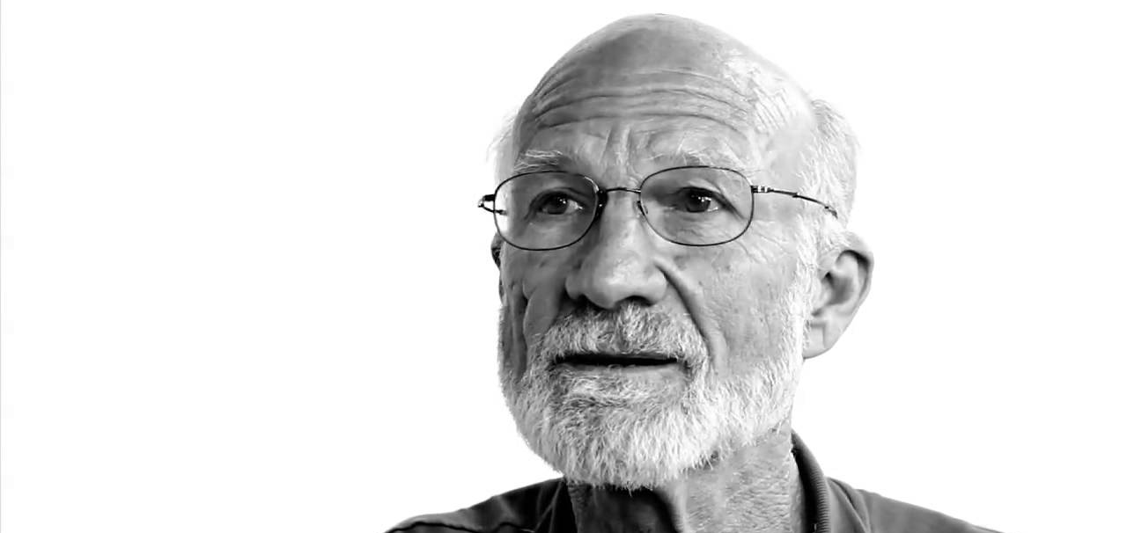

Slide 9

3. Counterfeit institutions
Digital platforms bypass gatekeepers hijack incentives, and manipulate user behaviour to extract and monetize our attention – at the cost of deforming individuals and unravelling society.

Slide 10
