Slide 1

In the way of Joy

Slide 2
1 Peter 2:11-12
“Dear friends, this world is not your home, so don’t make yourselves cozy in it. Don’t indulge your ego at the expense of your soul. Live an exemplary life in your neighborhood so that your actions will refute their prejudices. Then they’ll be won over to God’s side and be there to join in the celebration when he arrives.”

Slide 3
“Joy is Peace Dancing”

Slide 4
“Peace is Joy Resting”

Slide 5

“Joy is Peace Dancing” “Peace is Joy Resting”

Slide 6


Slide 7
The western formula for joy
Happiness is what you get when:
You maximise your freedom, through
2. Limitless choices at your disposal

Slide 8
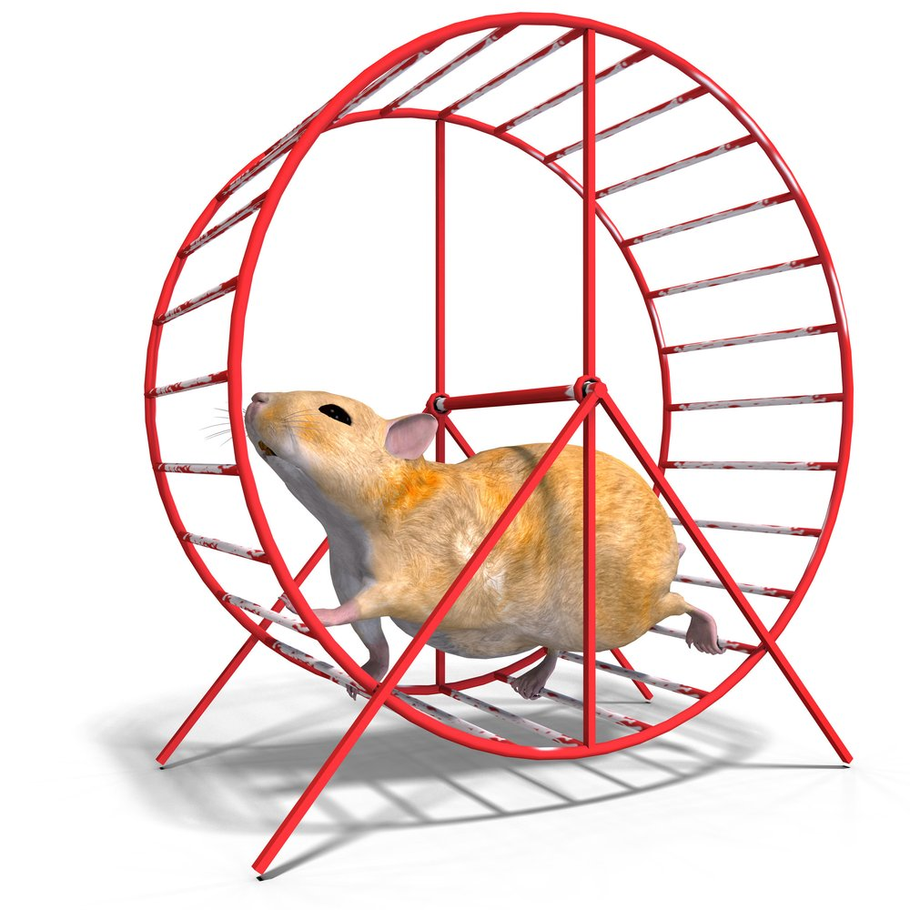
The pursuit of happiness...

Slide 9
What is addiction?
A chronic (i.e. lifelong) condition that involves compulsive seeking and taking of a substance or performing of an activity despite negative or harmful consequences.

Slide 10
Our biggest addiction?

Slide 11
Fear not!

Slide 12
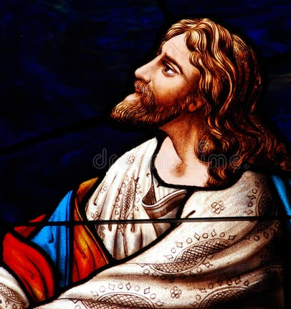
Dwell on the Lord

