Slide 1
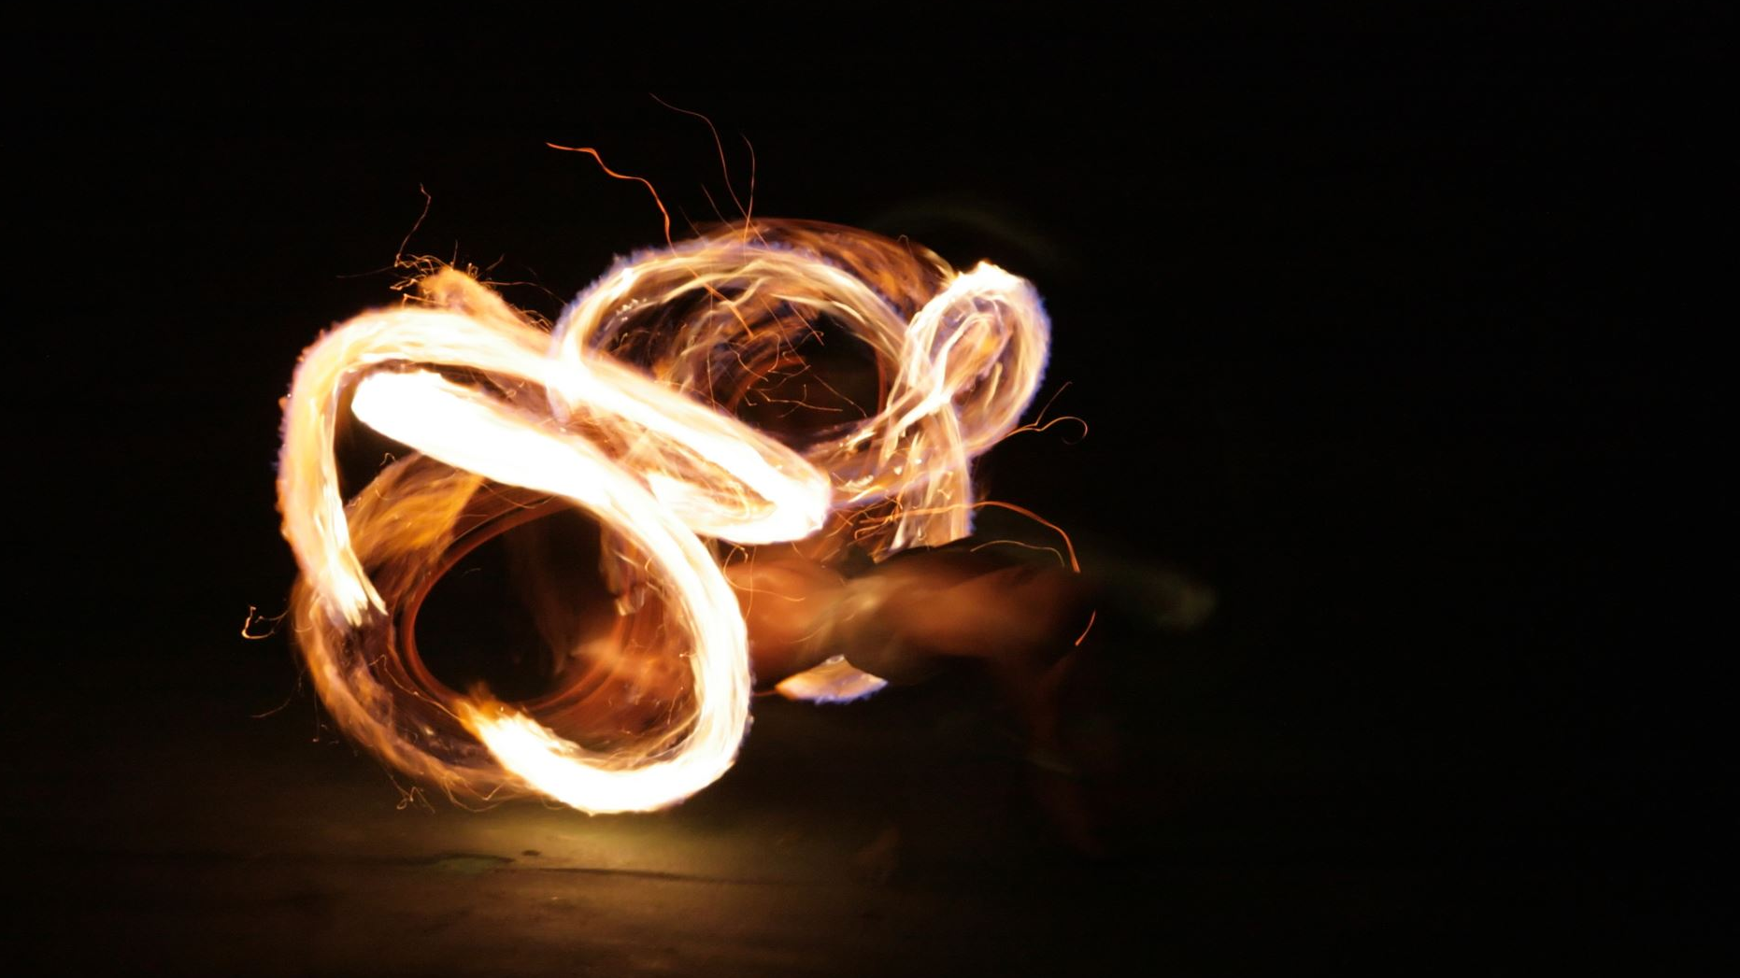
Soul, Body, Spirit
Preparing for the future

Slide 2
From our Statement of Faith
8. "We believe that Jesus Christ will return to earth to gather all believers to himself, and that he will appear to all as King of kings and Judge."

Slide 3
1 Corinthians 15:
²⁰ But as it is, Christ has been raised from the dead, the firstfruits of those who have fallen asleep. ²¹ For since death came through a man, the resurrection of the dead also comes through a man. ²² For just as in Adam all die, so also in Christ all will be made alive.

Slide 4
1 Corinthians 15:
²³ But each in his own order: Christ, the firstfruits; afterward, at his coming, those who belong to Christ. ²⁴ Then comes the end, when he hands over the kingdom to God the Father, when he abolishes all rule and all authority and power. ²⁵ For he must reign until he puts all his enemies under his feet. ²⁶ The last enemy to be abolished is death.

Slide 5
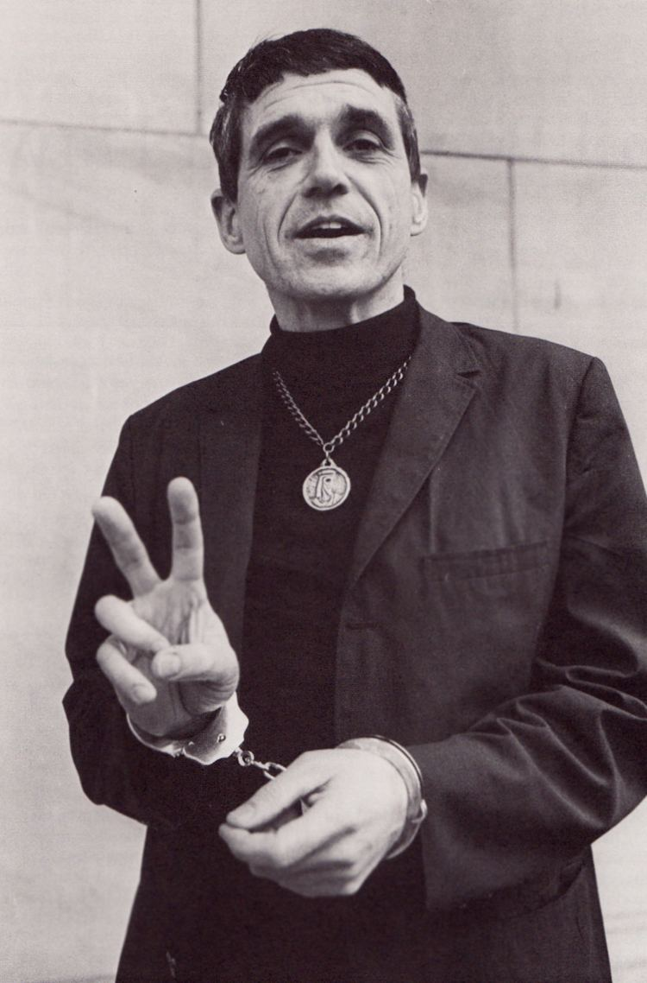
You're an inspired body!
"Therefore, brothers and sisters, in view of the mercies of God, I urge you to present your bodies as a living sacrifice, holy and pleasing to God; this is your true worship. Do not be conformed to this age, but be transformed by the renewing of your mind, so that you may discern what is the good, pleasing and perfect will of God.”

