Slide 1
The Temptations of Jesus
Matthew 4:1-11
The humanity of Jesus
The humility of Jesus
The temptations of Jesus
The divinity of Jesus

Slide 2
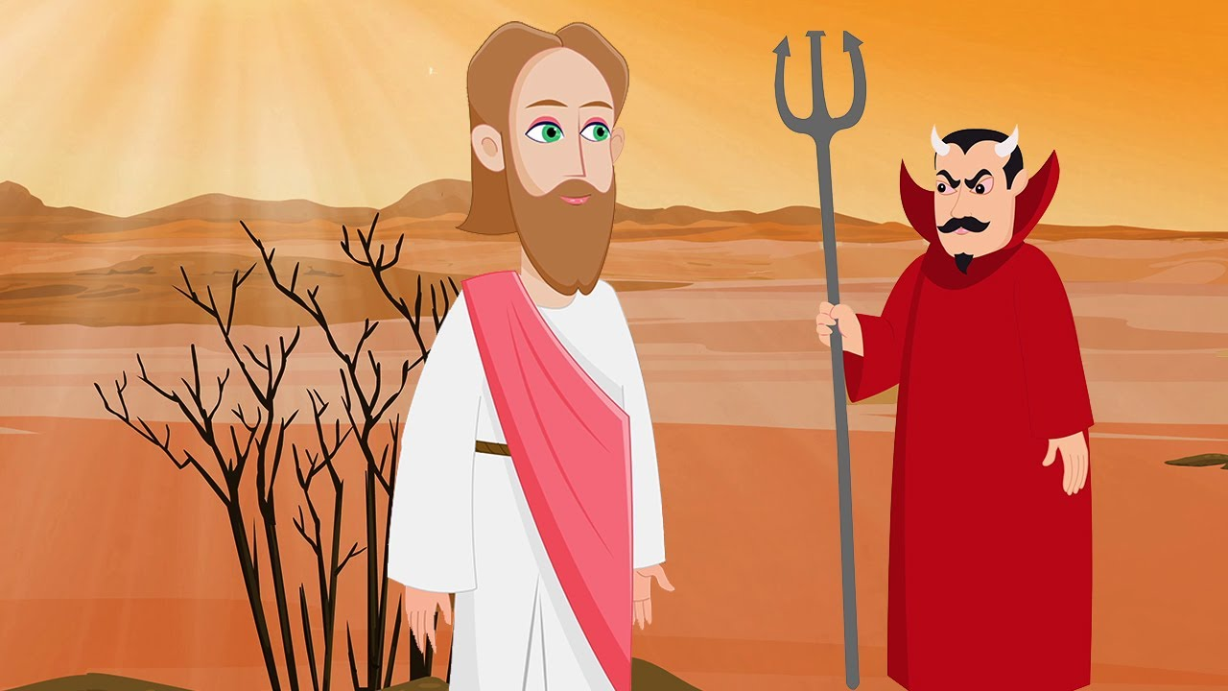
The Temptations of Jesus
Three Temptations

Slide 3
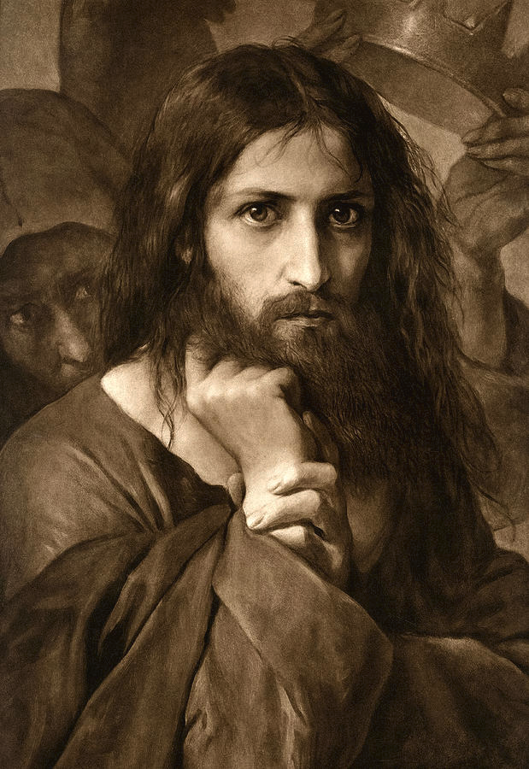
Georg Cornicelius

Slide 4
The Temptations of Jesus
- to turn stones into bread
(and have something to eat)
- to jump off the temple in the holy city (and not be hurt)
- to worship the devil (and thereby be given everything)

Slide 5
The Temptations of Jesus
Verses 1-2: Next, Jesus was taken into the wild by the Spirit for the Test. The Devil was ready to give it. Jesus prepared for the Test by fasting forty days and forty nights. That left him, of course, in a state of extreme hunger…

Slide 6
The First Temptation
Verses 3-4: [That left Jesus, of course, in a state of extreme hunger,] which the Devil took advantage of in the first test: “Since you are God’s Son, speak the word that will turn these stones into loaves of bread.”
Jesus answered by quoting Deuteronomy: “It takes more than bread to stay alive. It takes a steady stream of words from God’s mouth.”
Turning Stones into Bread

Slide 7
The Second Temptation
Verses 5-7: For the second test the Devil took him to the Holy City. He sat him on top of the Temple and said, “Since you are God’s Son, jump.” The Devil goaded him by quoting Psalm 91: “He has placed you in the care of angels. They will catch you so that you won’t so much as stub your toe on a stone.”
Jesus countered with another citation from Deuteronomy: “Don’t you dare test the Lord your God.”
Jump off the Temple

Slide 8
The Third Temptation
Verses 8-10: For the third test, the Devil took him to the peak of a huge mountain. He gestured expansively, pointing out all the earth’s kingdoms, how glorious they all were. Then he said, “They’re yours—lock, stock, and barrel. Just go down on your knees and worship me, and they’re yours.”
Jesus’ refusal was curt: “Beat it, Satan!” He backed his rebuke with a third quotation from Deuteronomy: “Worship the Lord your God, and only him. Serve him with absolute single-heartedness.”
Worship the Devil

Slide 9

The Temptations of Jesus
- to turn stones into bread to be relevant
- to jump off the temple in the holy city to be spectacular
- to worship the devil to be powerful

Slide 10
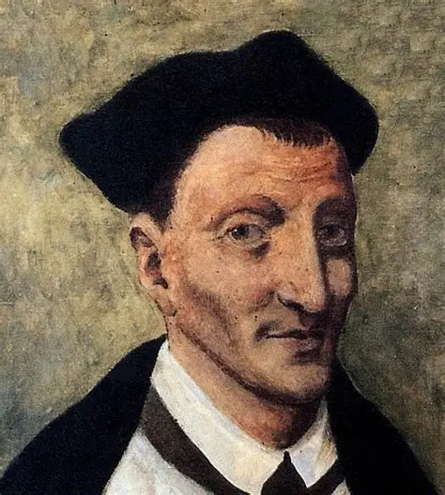
No one is so holy that they don’t have to deal with temptations.
Temptations can be useful – they can make us humble, cleanse and teach us.
Temptations are more easily overcome if they are never allowed to enter our minds. “Meet them at the door as soon as they knock, and do not let them in.”
Thomas à Kempis 1380-1471

Slide 11
The Temptations of Eve and Adam
1 John 2:16 “For all that is in the world, the lust of the flesh and the lust of the eyes and the boastful pride of life, is not from the Father, but is from the world.”
Genesis 3:6 “When the woman (Eve) saw that the tree
was good for food [lust of the flesh]
and that it was a delight to the eyes [lust of the eyes]
and that the tree was desirable to make one wise [pride of life]
she took from its fruit and ate".

Slide 13
Application
But be doers of the word, and not hearers only, deceiving yourselves.
James 2:16

Slide 14
Application
Consider it pure joy, my brothers and sisters, whenever you face trials of many kinds, because you know that the testing of your faith produces perseverance. Let perseverance finish its work so that you may be mature and complete, not lacking anything.
James 1:2-4

Slide 15

Application
I have hidden your word in my heart that I might not sin against you. Psalm 119:11
Learn verses of Scripture. Commit them to memory so that you own them…

Slide 16
Applications Summary
Sometimes, do something as a result of hearing a sermon. But be doers of the word, and not hearers only, deceiving yourselves. James 2:16
Trials and temptations help us to grow in Christ -> see them in a positive light. Consider it pure joy, my brothers and sisters, whenever you face trials of many kinds, because you know that the testing of your faith produces perseverance. Let perseverance finish its work so that you may be mature and complete, not lacking anything. James 1:2-4
Commit important Bible verses to memory. I have hidden your word in my heart that I might not sin against you. Psalm 119:11

Slide 17
The Temptations of Jesus
What kind of person do you want to be? Figure that out and go for it.
Temptations are (in God’s good design) ways by which we can become better (or worse) people.
When you are tempted, see it as an opportunity to grow as a follower of Jesus.

Slide 18
The Temptations of Jesus
to turn stones into bread
to jump off the temple in the holy city
to worship the devil
Our temptations can be seen as opportunities to grow in our faith and become more like Jesus

Slide 21
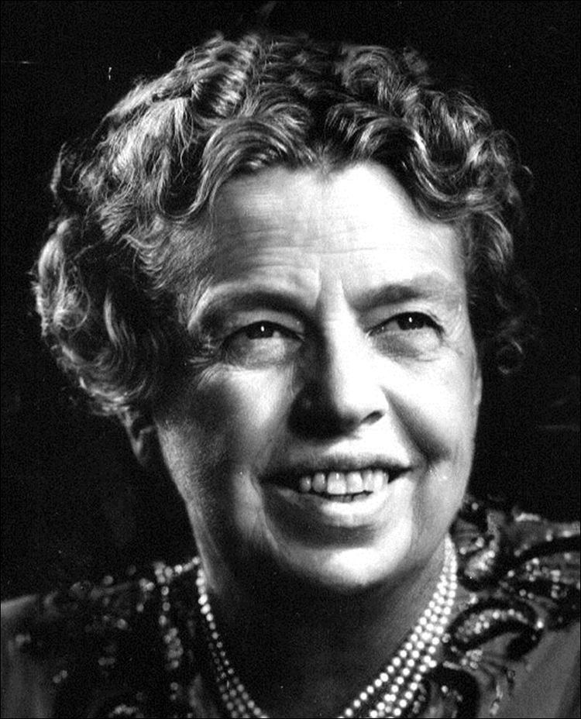
Who are you?
“I am the person I am today because of the choices I made yesterday.”
Eleanor Roosevelt

Slide 22
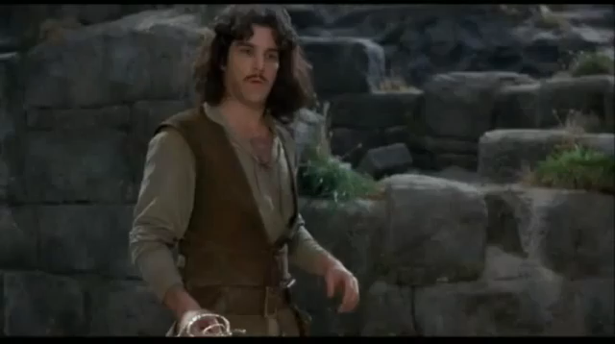
Who are you?
No one of consequence
I must know…
Get used to disappointment
OK

