Slide 1
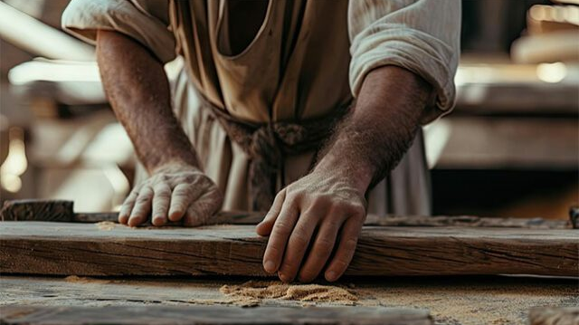
The humanity of Jesus

Slide 2

Philippians 2:5-11
Have this mind among yourselves, which is yours in Christ Jesus, who, though he was in the form of God, did not count equality with God a thing to be grasped, but emptied himself, by taking the form of a servant, being born in the likeness of men. And being found in human form, he humbled himself by becoming obedient to the point of death, even death on a cross.

Slide 3
Philippians 2:5-11
Therefore God has highly exalted him and bestowed on him the name that is above every name, so that at the name of Jesus every knee should bow, in heaven and on earth and under the earth, and every tongue confess that Jesus Christ is Lord, to the glory of God the Father.

Slide 4
"While you might not like being human, I do."
Love, Jesus.

Slide 5
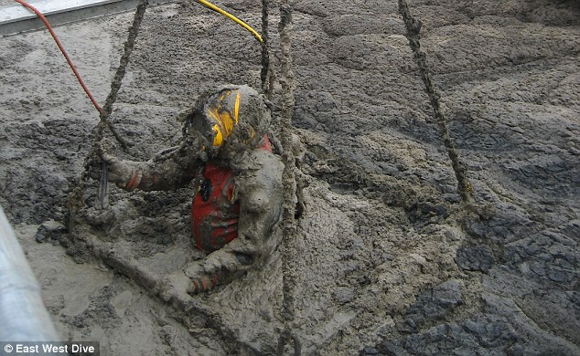

Slide 6
Defining some terms
"in the form of God"
"taking the form of a servant"
"born in the likeness of men"
"found in human form"

Slide 7

The Incarnation = one person with two natures

Slide 8
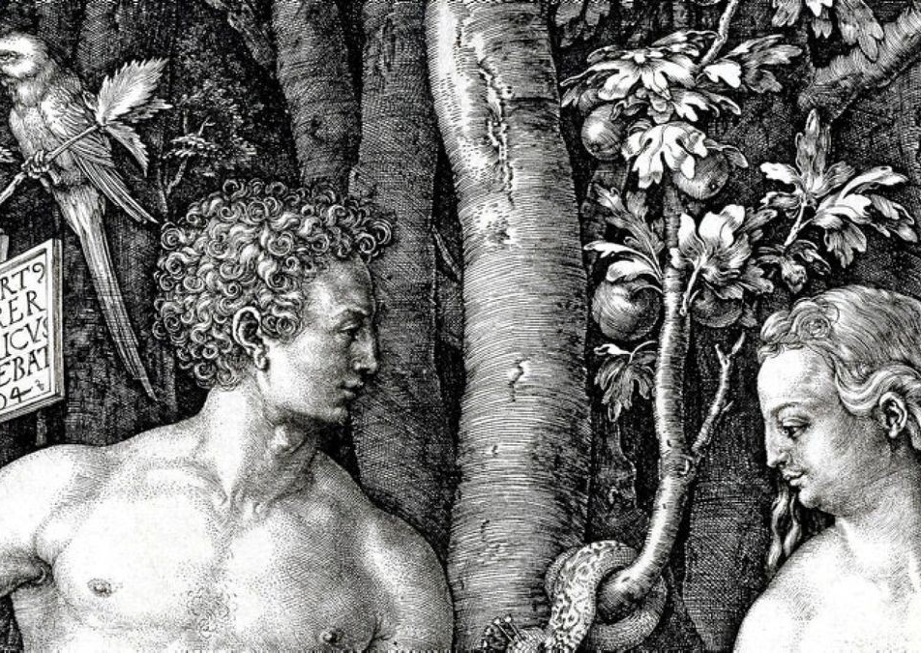
OUR problem: Genesis
Then God said, “Let us make man in our image, after our likeness."
So God created man in his own image, in the image of God he created him; male and female he created them.

Slide 9
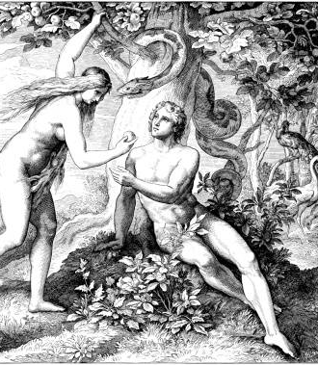
OUR problem
Now the serpent was more crafty than any other beast … and said to the woman, “God knows that when you eat of it your eyes will be opened, and you will be like God, knowing good and evil.”
So when the woman saw that ...the tree was to be desired to make one wise, she took of its fruit and ate, and she also gave some to her husband who was with her, and he ate.

Slide 10
What's the 'Therefore' there for?
"Therefore God has highly exalted him and bestowed on him the name that is above every name..."

