Slide 1
Mark 11:20-25
20.“In the morning, as they went along, they saw the fig-tree withered from the roots. 21.Peter remembered and said to Jesus, ‘Rabbi, look! The fig-tree you cursed has withered!’22. ‘Have faith in God,’ Jesus answered. 23.‘Truly I tell you, if anyone says to this mountain, “Go, throw yourself into the sea,” and does not doubt in their heart but believes that what they say will happen, it will be done for them. 24. Therefore, I tell you, whatever you ask for in prayer, believe that you have received it, and it will be yours. 25.And when you stand praying, if you hold anything against anyone, forgive them, so that your Father in heaven may forgive you your sins.”

Slide 2
Key themes of the Unit:
The withered fig tree cursed by Jesus – why?
Having Faith in God – Moving mountains
Prayer and Forgiveness

Slide 3
Having faith in God:
“Faith That Moves, Forgives, and Receives”
Mark 11:20-25

Slide 4
Mark 11:20–25
Faith That Move Mountains (11:22-23)
Prayer That Receives (11:24)
A Heart That Forgives (11:25)

Slide 5
I. Faith that Moves Mountains (v. 22–23)
What does having faith in God mean?
What does a lack of faith look like?
What does having faith in God as small as a mustard seed look like?
What kind of faith moves mountains?
What are your mountains today?

Slide 6
II. Prayer That Receives (v. 24)
Ask
Believe
Receive

Slide 7
III. A Heart That Forgives (v. 25)
Why forgiveness matters:
Unforgiveness clogs the spiritual pipeline.
God forgave you, so you must forgive others.
Forgiveness isn’t a feeling—it’s a decision.

Slide 8
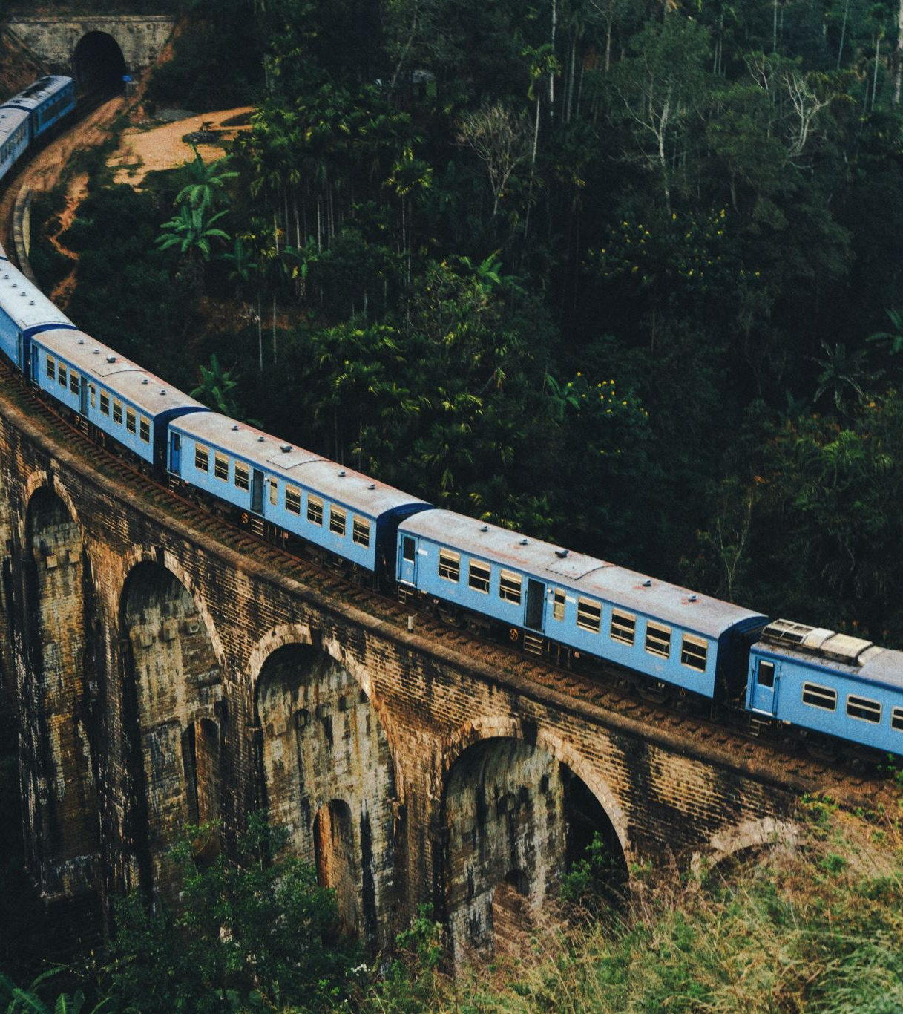
MEGST’s Vision
MEGST trains and equips Christians to be Christ-like leaders who build up the church and the nation of Myanmar and beyond.

Slide 9
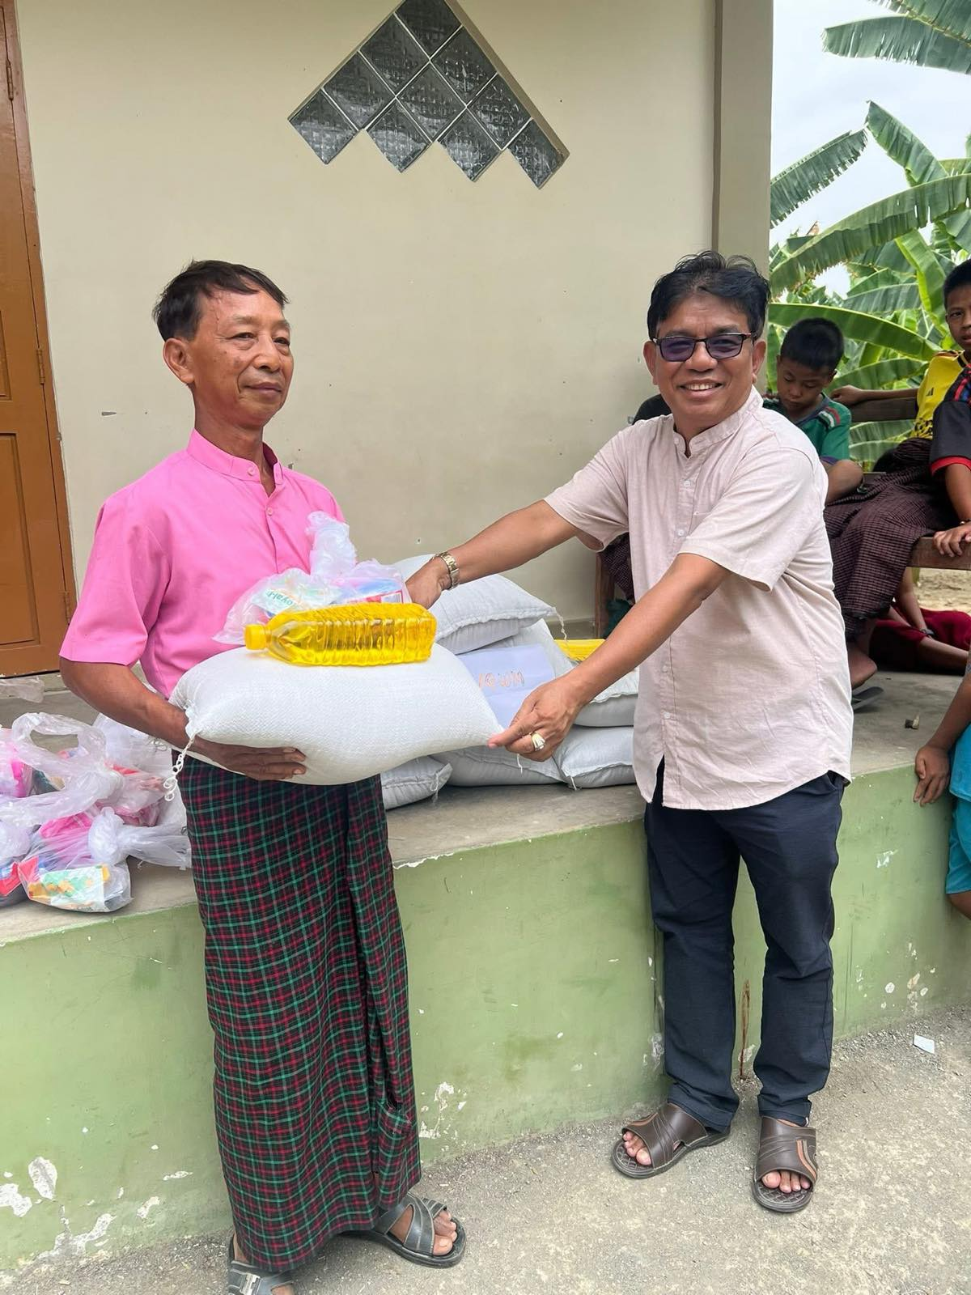
MEGST Alumni

Slide 10
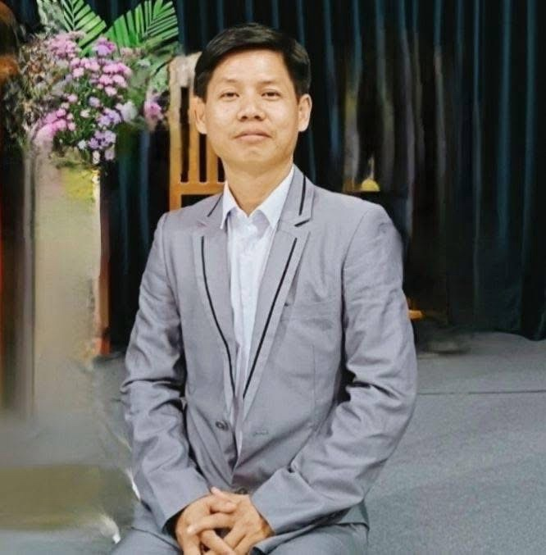
MEGST Alumni

Slide 11
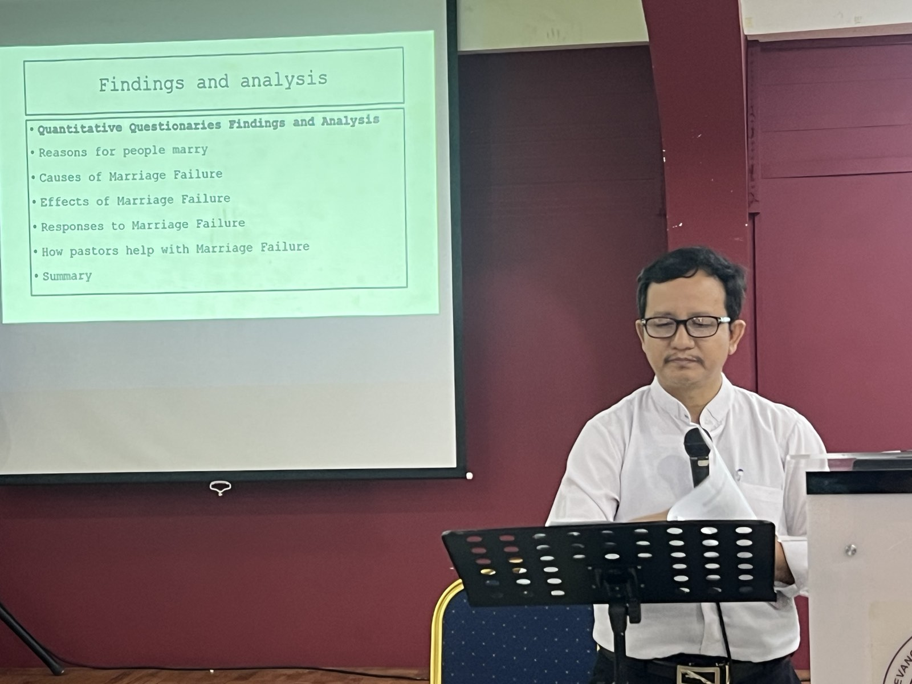
MEGST Alumni

Slide 12
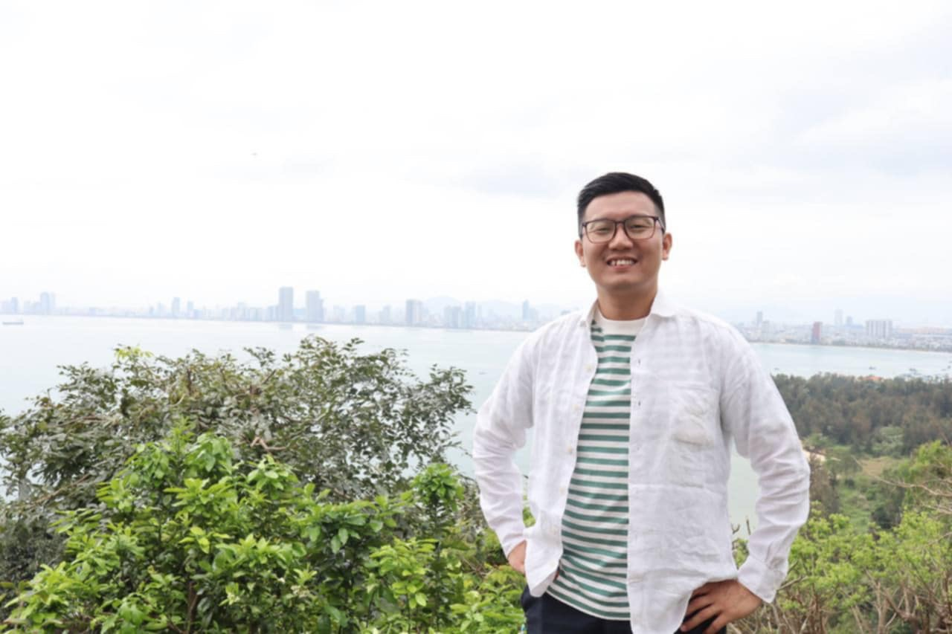
MEGST Alumni

Slide 13
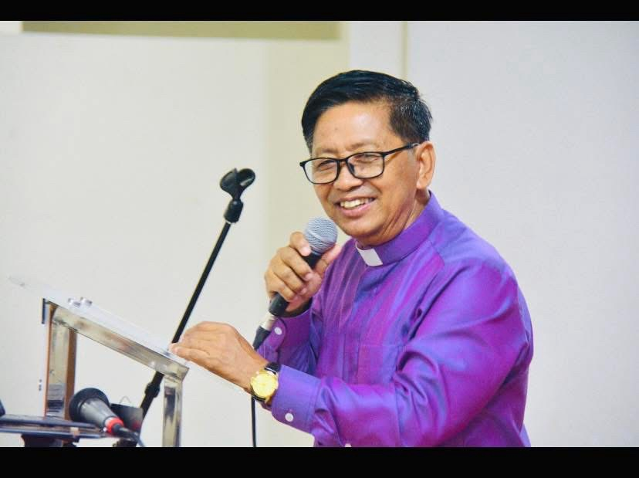
MEGST Alumni

Slide 14
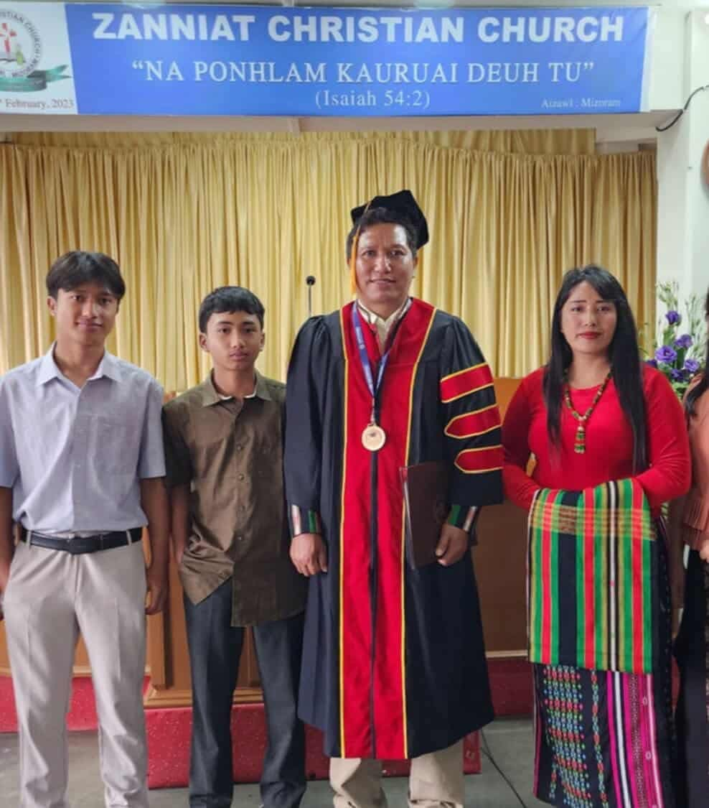
MEGST Alumni

Slide 15
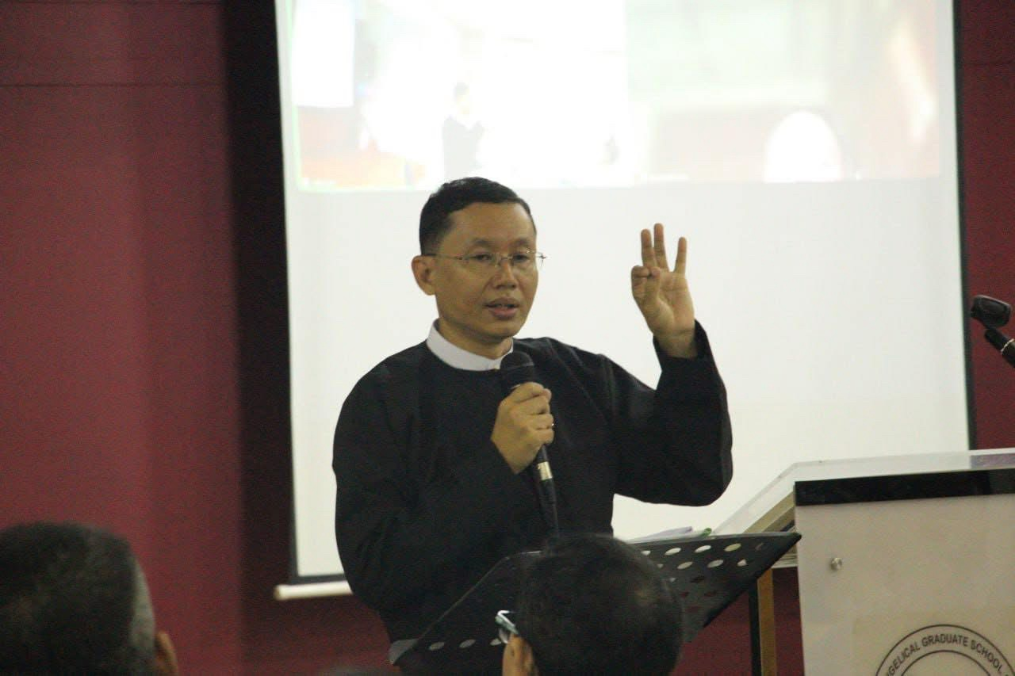
MEGST Alumni

