Slide 1

Who is Beacon Partnerships?
Affiliated to the only two networks in the world who solely focus on supporting Christian leadership training in the Majority World: The Overseas Council network and Langham Partnership.
We have expertise and experience in fundraising, cross cultural communication, and theological education.
Vision: to see servant leaders in Asia Pacific equipped and engaged in mission who can teach and apply the Word of God in their context.

Slide 2

The status of global Christianity
72,500 coming to Christ each day/ 500,000 a week
If each church is 100 people, then 725 churches needed each day and leaders to guide them (725 pastors/ elders every day)
See www.worldchristiandatabase.org and www.globalchristianity.org
Most Christian charities are humanitarian… only a handful of charities support the training of Christian leaders.
The need is urgent!

Slide 3
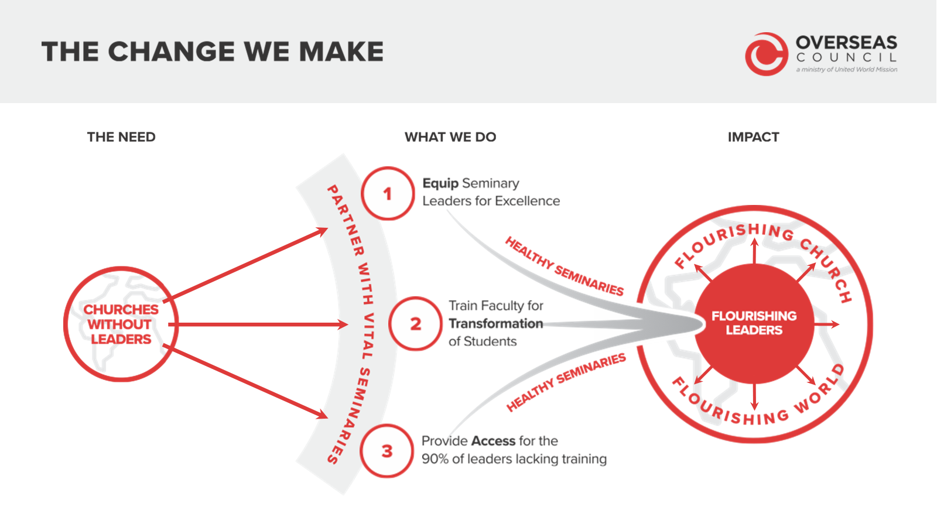

Slide 4
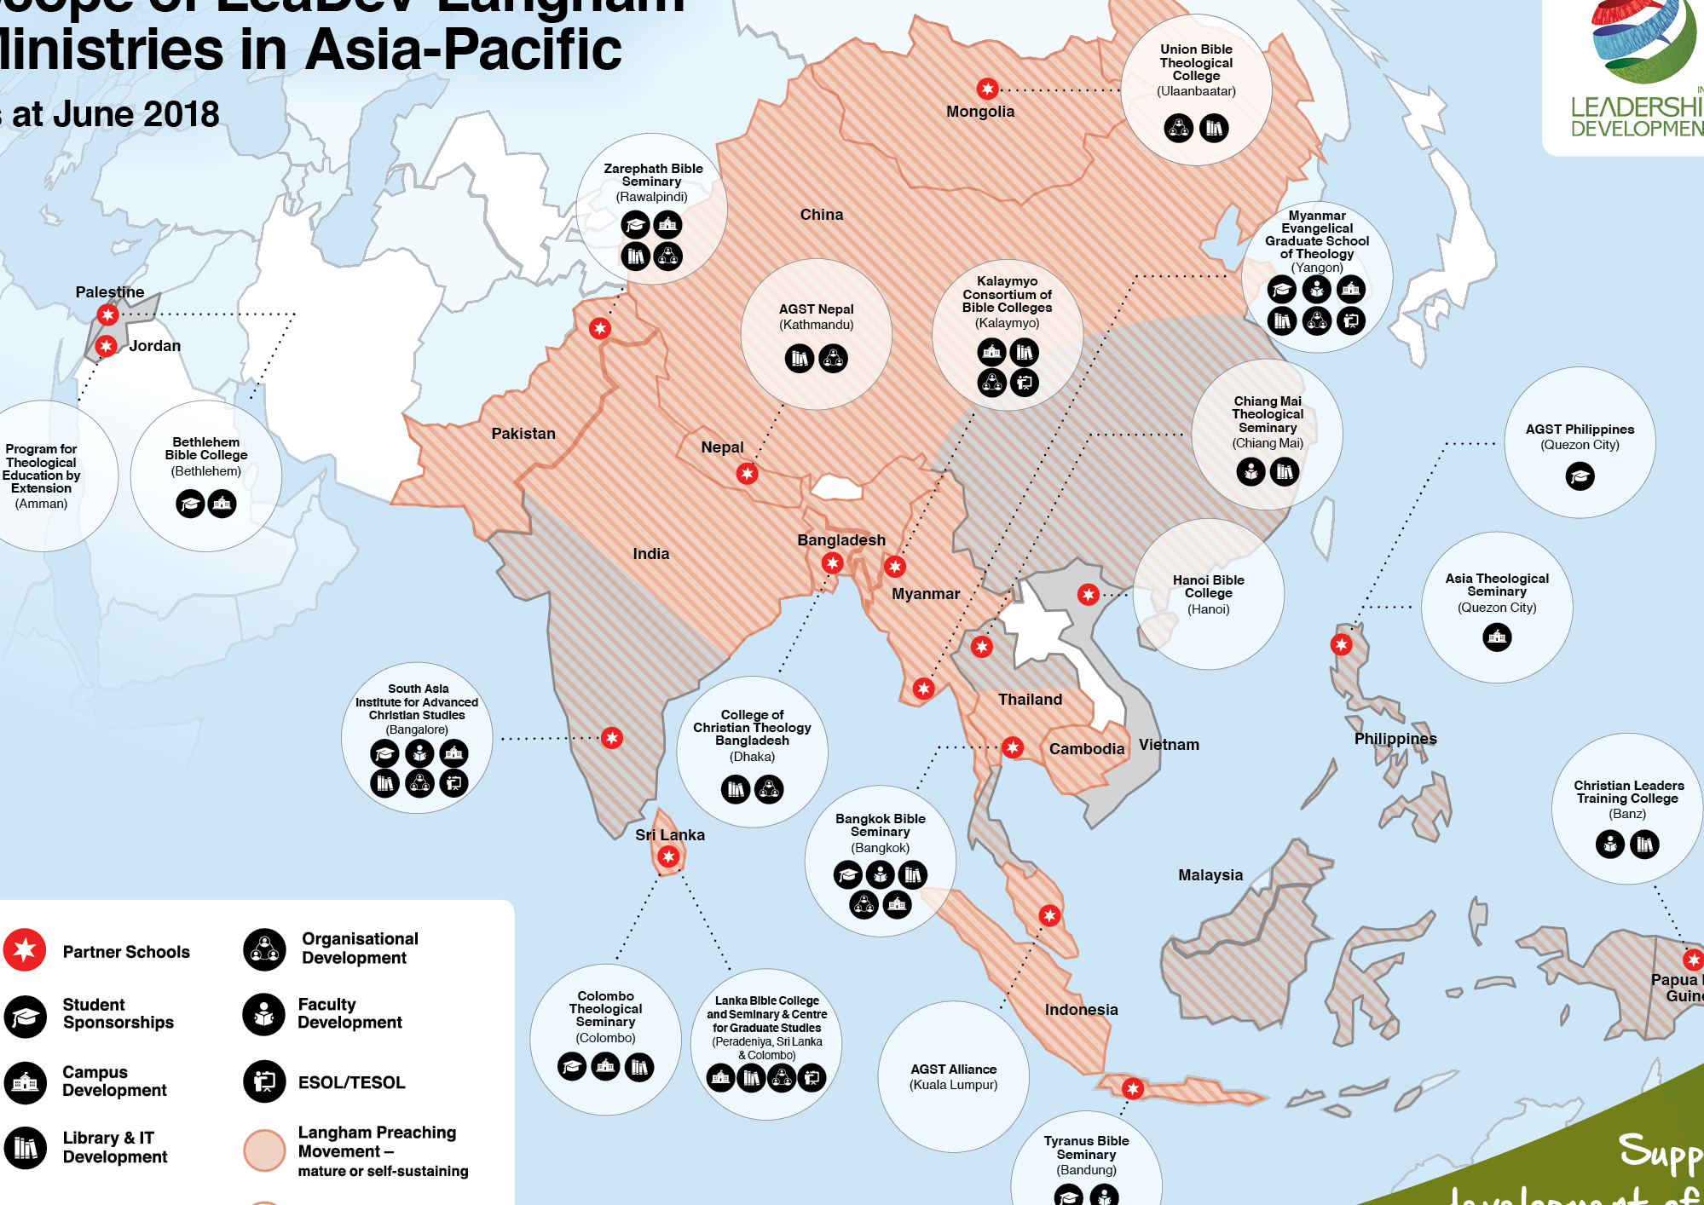

Slide 5
Equipping emerging leaders
impoverished students sponsored.
Preacher training
Preachers received free books at Langham preaching seminars.
Bridging the resource gap
Partner School campuses upgraded, including online classrooms
Providing ESOL and Academic coaching. We are so thankful for dedicated teams and for the input from volunteers especially.
Sustainability projects

Slide 6
Multiplying the ministries of senior leaders
leaders are fully sponsored for masters or doctoral study through both Beacon Partnerships and Langham Scholars.
Taking compassionate action
Ukraine, Myanmar, Beirut
trauma counselling, providing relief in emergencies .

Slide 7
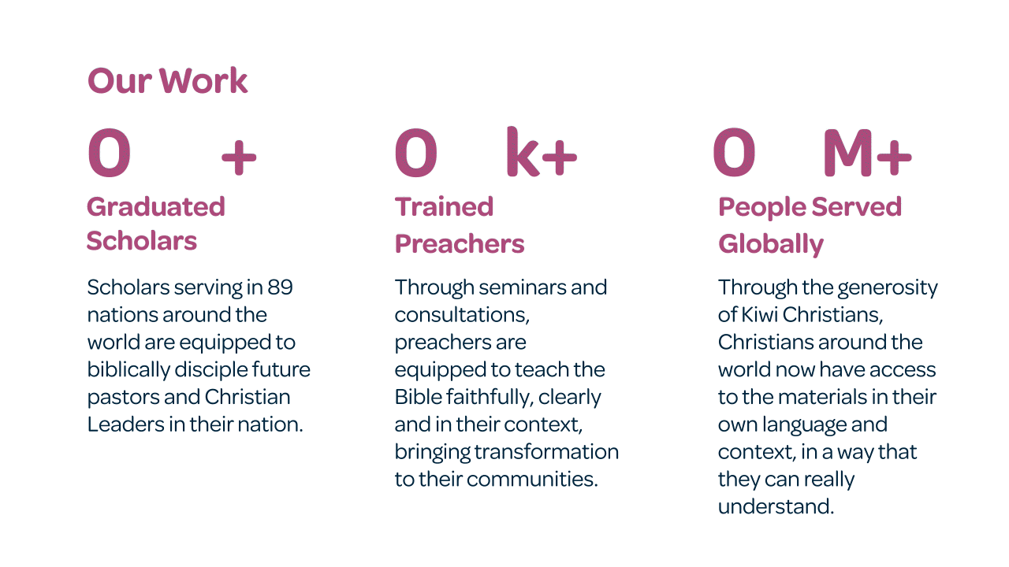

Slide 8
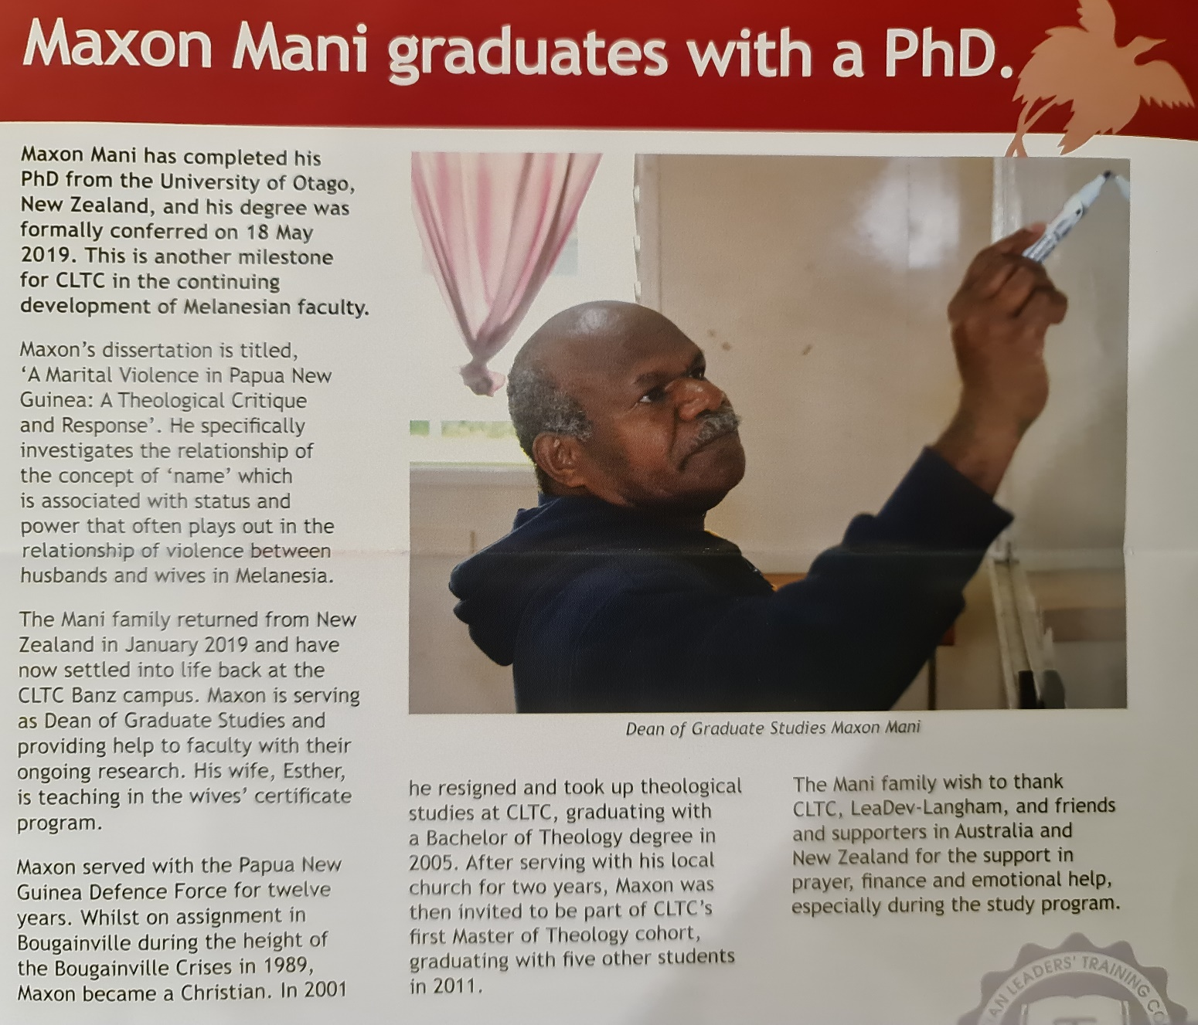

Results …
George Mombi- regional facilitator based at CLTC/ Graduate Studies Dean CLTC.
Maxon Mani- Prinicpal CLTC.
Making an impact!
Notes:
This could possibly be individual slides: photo and the result

Slide 9
New opportunities
PhD, Herry Susanto and his family studying at Otago, August 2022-25
Cost of studies/ rental
Total= $5000 a month for one, $10,000 per month for 2, for 4 years.
Mem and Up from Thailand to study toward a PhD at Laidlaw 2023-2027; Buddhist background Christians who will make a difference!
Sustainability initiatives: CLTC solar power/ Early Childhood teacher education.
Seedbed preaching initiative in the Pacific Islands. 40,000 per year
- For training the trainers at grass roots level.

