Slide 1
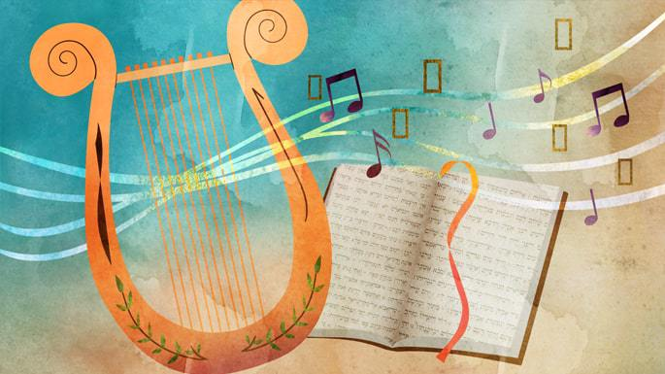
Psalms
Art by Sefira Lightstone

Slide 2
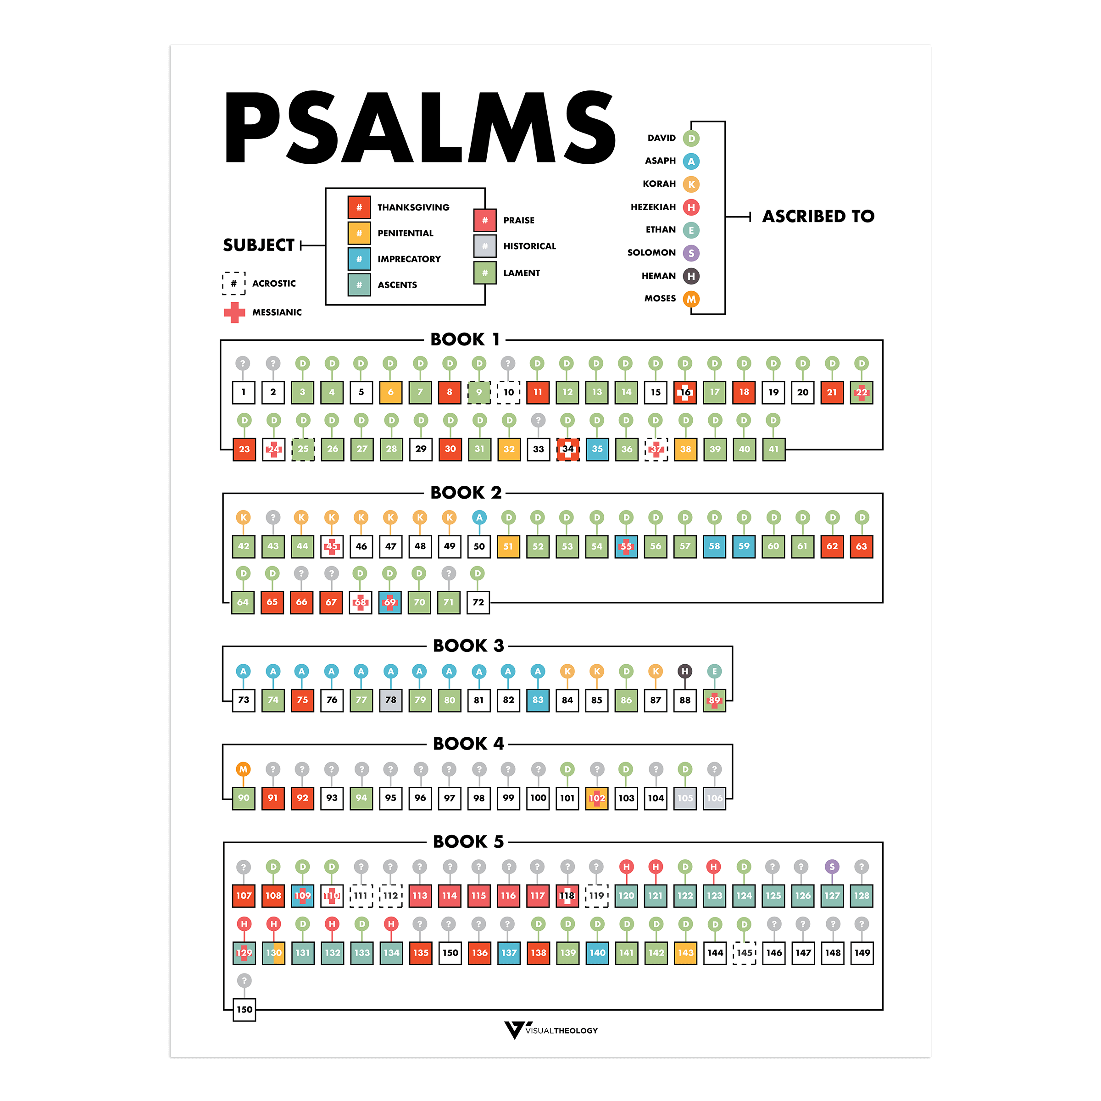

Slide 3
Philippians 2:5-9
⁵ Let the same mind be in you that was in Christ Jesus,
⁶ who, though he was in the form of God,
did not regard equality with God
as something to be exploited,
⁷ but emptied himself, taking the form of a slave,
being born in human likeness.
And being found in human form,
⁸ he humbled himself
and became obedient to the point of death— even death on a cross.
⁹ Therefore God also highly exalted him
and gave him the name that is above every name,…
Orientation
Disorientation
New Orientation

Slide 4


Slide 5
THE ONE SLIDE SUMMARY OF EVERYTHING
Psalms of Orientation
Psalms of Disorientation
Psalms of New Orientation
Songs of guaranteed creation
Songs of surprising new life
Songs of disarray
First move SUFFERING
Second move HOPE
Example of Jesus
Crucifixion
Resurrection

Slide 6
Moses
Orientation
Disorientation
New Orientation
In the court of Pharoah
40 years a shepherd
Leads Israel into the Promised Land

Slide 7
Psalms of Orientation (Examples)
Songs of Creation
Songs of Torah
Wisdom Psalms
Occasions of Well-Being
Psalm 8
Psalm 33
Psalm 104
Psalm 145
Psalm 1
Psalm 15
Psalm 19
Psalm 24
Psalm 119
Psalm 14
Psalm 37
Psalm 16
Psalm 131
Psalm 133

Slide 8
Songs of Creation
3 When I look at your heavens, the work of your fingers,
the moon and the stars that you have established;
4 what are human beings that you are mindful of them,
mortals that you care for them?
5 Yet you have made them a little lower than God,
and crowned them with glory and honor.
Psalm 8
Psalm 33
Psalm 104
Psalm 145

Slide 9
Songs of Torah
1 Happy are those
who do not follow the advice of the wicked,
or take the path that sinners tread,
or sit in the seat of scoffers;
2 but their delight is in the law of the Lord,
and on his law they meditate day and night.
3 They are like trees
planted by streams of water,
which yield their fruit in its season,
and their leaves do not wither.
In all that they do, they prosper.
Psalm 1
Psalm 15
Psalm 19
Psalm 24
Psalm 119

Slide 10
Wisdom Psalms
1 Fools say in their hearts, “There is no God.”
They are corrupt, they do abominable deeds;
there is no one who does good.
2 The Lord looks down from heaven on humankind
to see if there are any who are wise,
who seek after God.
3 They have all gone astray, they are all alike perverse;
there is no one who does good, no, not one.
7 O that deliverance for Israel would come from Zion!
When the Lord restores the fortunes of his people,
Jacob will rejoice; Israel will be glad.
Psalm 14
Psalm 37

Slide 11
Occasions of Well-Being
1 O Lord, my heart is not lifted up,
my eyes are not raised too high;
I do not occupy myself with things
too great and too marvellous for me.
2 But I have calmed and quieted my soul,
like a weaned child with its mother;
my soul is like the weaned child that is with me.
3 O Israel, hope in the Lord
from this time on and forevermore.
Psalm 131
Psalm 133

Slide 12
Psalms of Orientation
Psalms of Disorientation
Psalms of New Orientation
Songs of guaranteed creation
Songs of surprising new life
Songs of disarray
First move SUFFERING
Second move HOPE

Slide 13
Psalms of Disorientation (Examples)
Personal Complaint
Communal Complaint
God’s Complaint
Psalm 13
Psalm 35
Psalm 86
Psalm 74
Psalm 79
Psalm 137
Psalm 50
Psalm 81

Slide 14
Personal Complaint
1 How long, O LORD? Will you forget me forever?
How long will you hide your face from me?
2 How long must I bear pain in my soul,
and have sorrow in my heart all day long?
How long shall my enemy be exalted over me?
… 5 But I trust in your unfailing love, my heart rejoices in your salvation. I will sing the Lord’s praise, for he has been good to me.
Psalm 13
Psalm 35
Psalm 86

Slide 15

Communal Complaint
By the rivers of Babylon there we sat down
Yeah, we wept when we remembered Zion
By the rivers of Babylon there we sat down
Yeah, we wept when we remembered Zion
When the wicked carried us away in captivity
Required from us a song
Now how shall we sing the Lord's song
In a strange land?...
Psalm 74
Psalm 79
Psalm 137

Slide 16
God’s Complaint
11 “But my people did not listen to my voice;
Israel would not submit to me.
12 So I gave them over to their stubborn hearts, to follow their own counsels.
Psalm 50
Psalm 81

Slide 17
Psalms of Orientation
Psalms of Disorientation
Psalms of New Orientation
Songs of guaranteed creation
Songs of surprising new life
Songs of disarray
First move SUFFERING
Second move HOPE

Slide 18
Psalms of New Orientation (Examples)
Personal Thanksgiving
Community Thanksgiving
Once and Future King
Hymns of Praise
Psalm 29
Psalm 47
Psalm 93
Psalm 97
Psalm 65
Psalm 66
Psalm 124
Psalm 129
Psalm 29
Psalm 47
Psalm 93
Psalm 97
Psalm 98
Psalm 114
Psalm 100
Psalm 103
Psalm 113
Psalm 117
Psalm 135
Psalm 146-150

Slide 19
Hymns of Praise
Shout for joy to the Lord, all the earth.
Worship the Lord with gladness; come before him with joyful songs.
Know that the Lord is God. It is he who made us, and we are his; we are his people, the sheep of his pasture.
Psalm 100
Psalm 103
Psalm 113
Psalm 117
Psalm 135
Psalm 146-150

Slide 20
Psalms of Orientation
Psalms of Disorientation
Psalms of New Orientation
Songs of guaranteed creation
Songs of surprising new life
Songs of disarray

Slide 21
Psalms
Read Me
Art by Sefira Lightstone

Slide 22
Psalm 71
⁹ Do not cast me away when I am old; do not forsake me when my strength is gone. ¹⁰ For my enemies speak against me; those who wait to kill me conspire together. ¹¹ They say, “God has forsaken him; pursue him and seize him, for no one will rescue him.” ¹² Do not be far from me, my God; come quickly, God, to help me. ¹³ May my accusers perish in shame; may those who want to harm me be covered with scorn and disgrace.
¹⁴ As for me, I will always have hope; I will praise you more and more.
¹⁵ My mouth will tell of your righteous deeds, of your saving acts all day long— though I know not how to relate them all. ¹⁶ I will come and proclaim your mighty acts, Sovereign Lord; I will proclaim your righteous deeds, yours alone. ¹⁷ Since my youth, God, you have taught me, and to this day I declare your marvelous deeds. ¹⁸ Even when I am old and gray, do not forsake me, my God, till I declare your power to the next generation, your mighty acts to all who are to come.
¹⁹ Your righteousness, God, reaches to the heavens, you who have done great things. Who is like you, God? ²⁰ Though you have made me see troubles, many and bitter, you will restore my life again; from the depths of the earth you will again bring me up. ²¹ You will increase my honor and comfort me once more.
²² I will praise you with the harp for your faithfulness, my God; I will sing praise to you with the lyre, Holy One of Israel. ²³ My lips will shout for joy when I sing praise to you— I whom you have delivered. ²⁴ My tongue will tell of your righteous acts all day long, for those who wanted to harm me have been put to shame and confusion.
¹ In you, Lord, I have taken refuge; let me never be put to shame. ² In your righteousness, rescue me and deliver me; turn your ear to me and save me. ³ Be my rock of refuge, to which I can always go; give the command to save me, for you are my rock and my fortress. ⁴ Deliver me, my God, from the hand of the wicked, from the grasp of those who are evil and cruel.
⁵ For you have been my hope, Sovereign Lord, my confidence since my youth. ⁶ From birth I have relied on you; you brought me forth from my mother’s womb. I will ever praise you. ⁷ I have become a sign to many; you are my strong refuge. ⁸ My mouth is filled with your praise, declaring your splendor all day long.

Slide 23
The Structure of Psalm 71
A. Prayer of Confidence (vv. 1–4)
B. Affirmation of Confidence (vv. 5–8)
C. Prayer in Old Age (vv. 9–13)
C′. Hope in Old Age (vv. 14–18)
B′. Affirmation of Confidence (vv. 19–21)
A′. Thanksgiving With Confidence (vv. 22–24)

