Slide 1

Spiritual seasons

Slide 2

Spring

Slide 3
Spring
Insights:
Moving from winter to spring can be upsetting.
We might indeed need a push
Feeling unready is normal.
There is no age restriction
Good questions:
What good habits need to be given up for a new thing?
What humbling action might be necessary for new growth?

Slide 4
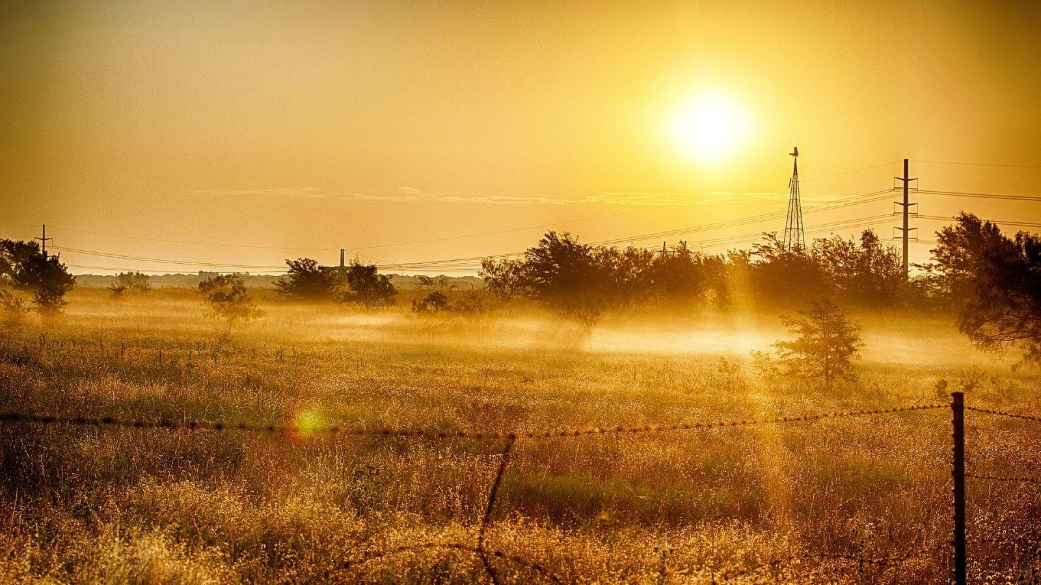
In the season of summer
John, chapters 4-12

Slide 5
A season marked by...
Active; growing in power, mastery, authority, influence
Conflict and struggle
Heavy demands that wear you out
Purposeful labour that energises and gives life
Working with others and for others

Slide 6
Good questions:
What work are you doing with God?
What are your gifts, what energises you and makes you feel like "I was born to do this!"?
Where is God at work in your life?

Slide 7

Autumn with Jesus
John 13-17

Slide 8

Autumn overview
A considerable change of pace
A sharpened focus
Taking stock, handing on, final words
Feelings of displacement / replacement
A gift we give so others can grow

Slide 9
Some questions:
Q: Who is taking your place?
Q: What could you do to help be replaced?
Q: What might make it hard for you to let go of something you have poured yourself into?

Slide 10

Wintering with Jesus
John 19

Slide 11

Winter takes
Ever lost a sense of God’s presence?
Ever lost a sense of purpose or direction?
Ever found spiritual habits dry up and become lifeless?

Slide 12
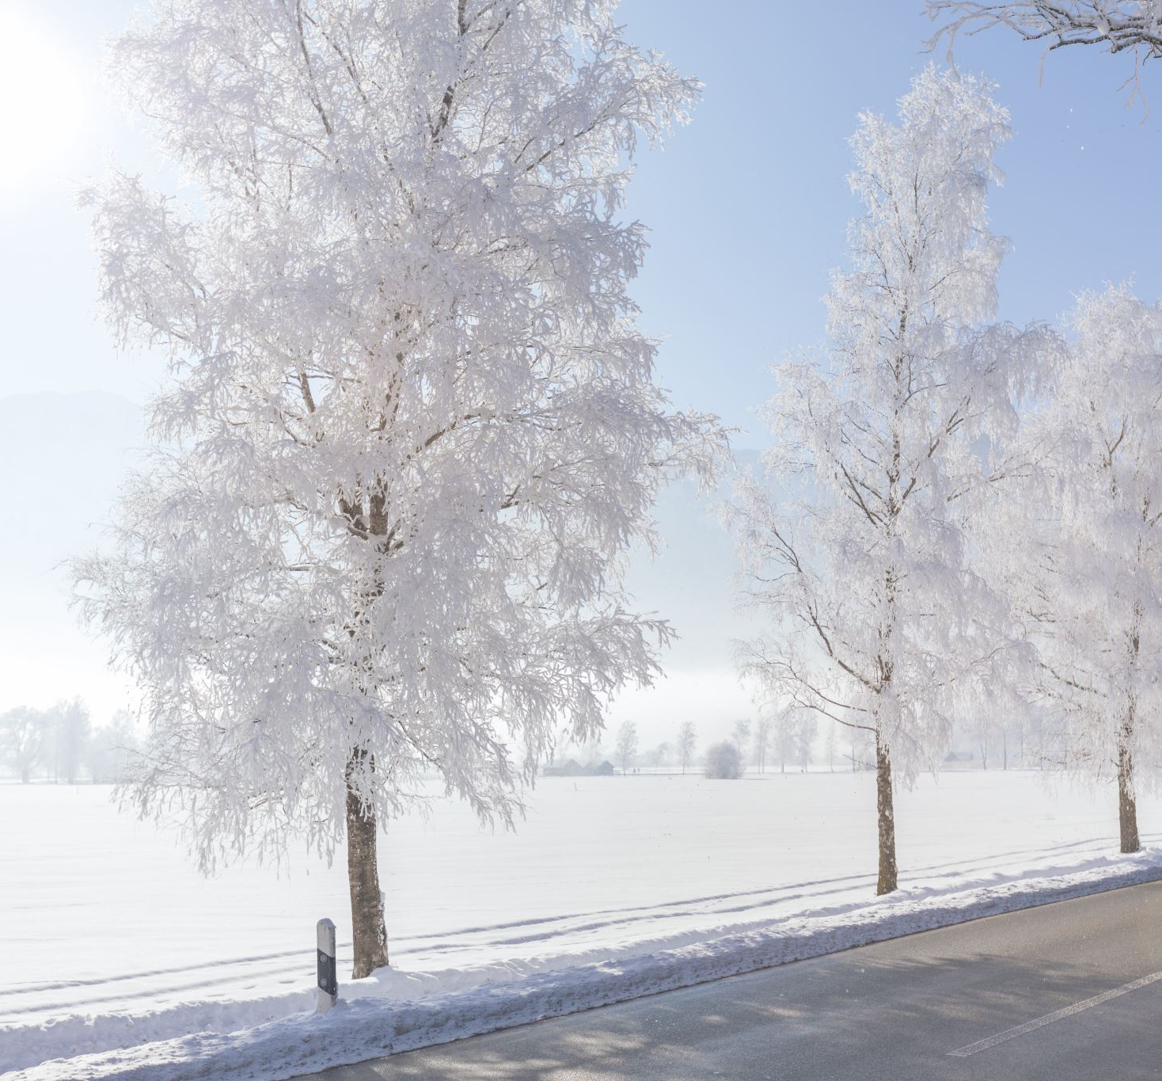
Winter gives...a purified faith.

Slide 13
Which season speaks to you?
What might God be inviting you to do with him?

