Slide 1
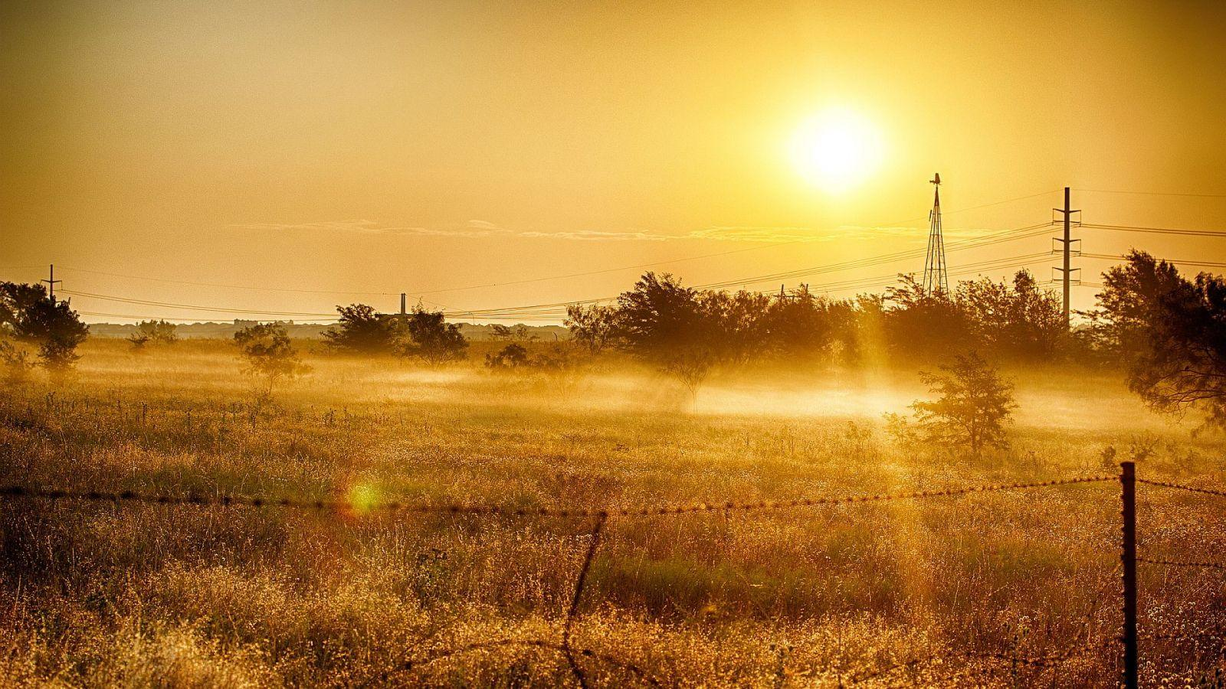
In the season of summer
John, chapters 4-12

Slide 2
It is a season marked by...
Active; growing in power, mastery, authority, influence
Conflict and struggle
Heavy demands that wear you out
Purposeful labour that energises and gives life
Working with others and for others

Slide 3
Consider this:
You WILL get worn out.

Slide 4
Consider this:
You will get worn out.
Work THROUGH it, don't run from it.

Slide 5
Consider this:
You will get worn out.
Work through it, don't run from it.
Not just ANY work, for ANY food

Slide 6
Life-giving work:
Serving God,
With purpose / gifts
Where you are

Slide 7
Serving God
We are more than bodies – we are spiritual
Serving with the Life-Giver is life-giving
And he pulls with us

Slide 8
With purpose
Not just ANY work – work you were designed for
Don't confuse busy with effective

Slide 9
Where you are
God is with you, there
See everything as His; it's true, and makes 'your' work easier

Slide 10
Good questions:
What work are you doing with God?
What are your gifts, what energises you and makes you feel like "I was born to do this!"?
Where is God at work in your life?

Slide 11
Final thoughts, I promise

Slide 12
Think 'holy days' more than holidays

Slide 13
Think 'teamwork' more than 'lone hero'

Slide 14
Above all "enjoy your summer"!

