Slide 1
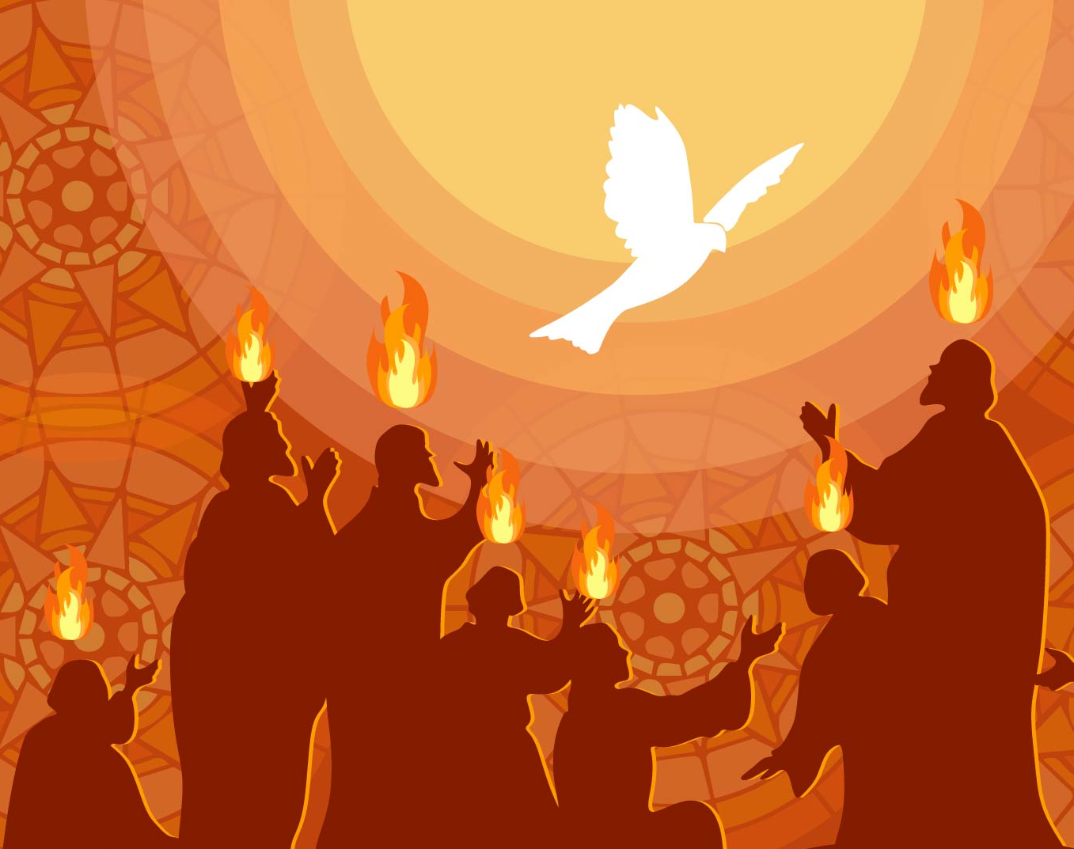
Gripped by Pentecost power
Becoming unshakable.

