Slide 1
Hebrews 10:26-39
A matter of perspective

Slide 2
3 christian perspectives

Slide 3
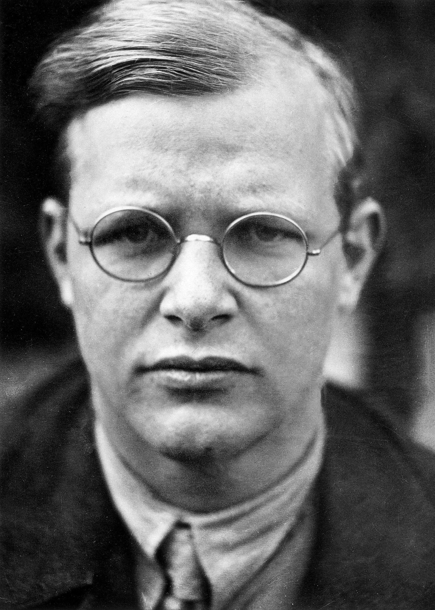
#1 Perspective
The danger of cheap grace

Slide 4
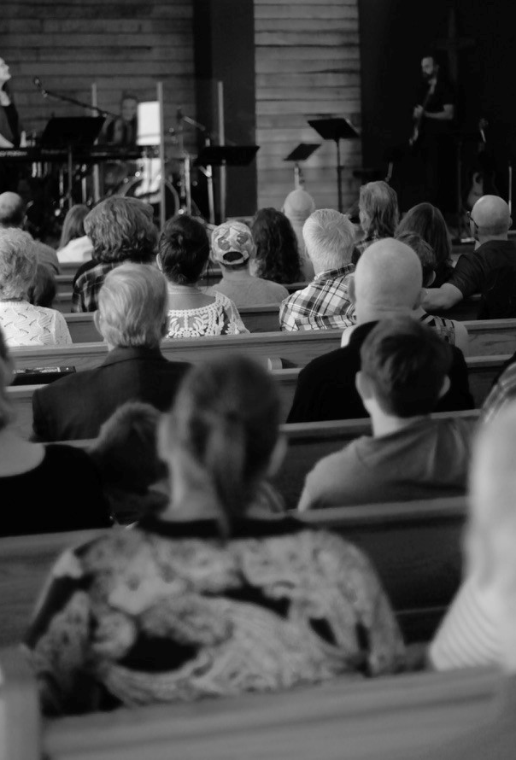
#2 Perspective
Attendance is a blunt but useful measure

Slide 5
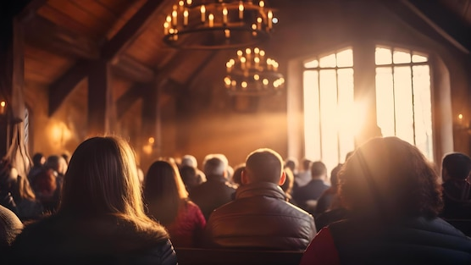
#3 Perspective
Your true best life

