Slide 1
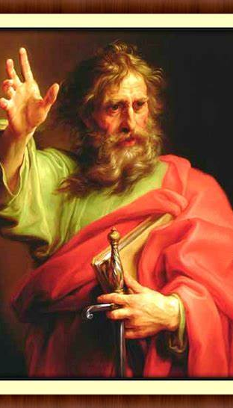
Peterson v Paul

Slide 2
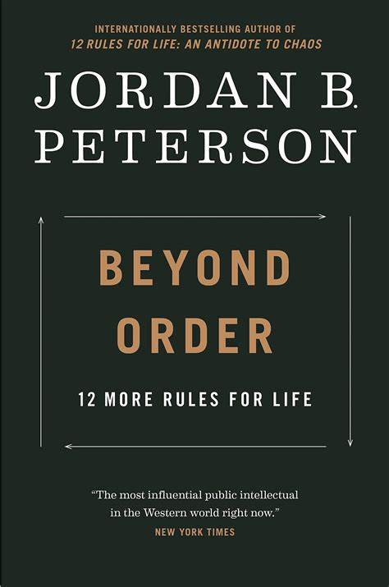
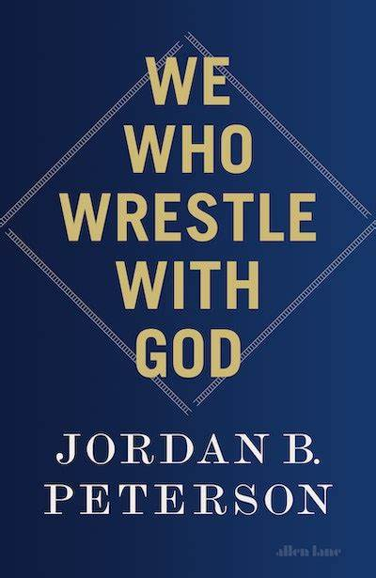

Slide 3
^{15:3} For I delivered to you as of first importance what I also received: that Christ died for our sins in accordance with the Scriptures, ⁴ that he was buried, that he was raised on the third day in accordance with the Scriptures, ⁵ and that he appeared to Cephas, then to the twelve. ⁶ Then he appeared to more than five hundred brothers at one time, most of whom are still alive, though some have fallen asleep. ..
¹⁷ And if Christ has not been raised, your faith is futile and you are still in your sins. ¹⁸ Then those also who have fallen asleep in Christ have perished. ¹⁹ If in Christ we have hope in this life only, we are of all people most to be pitied.

Slide 4
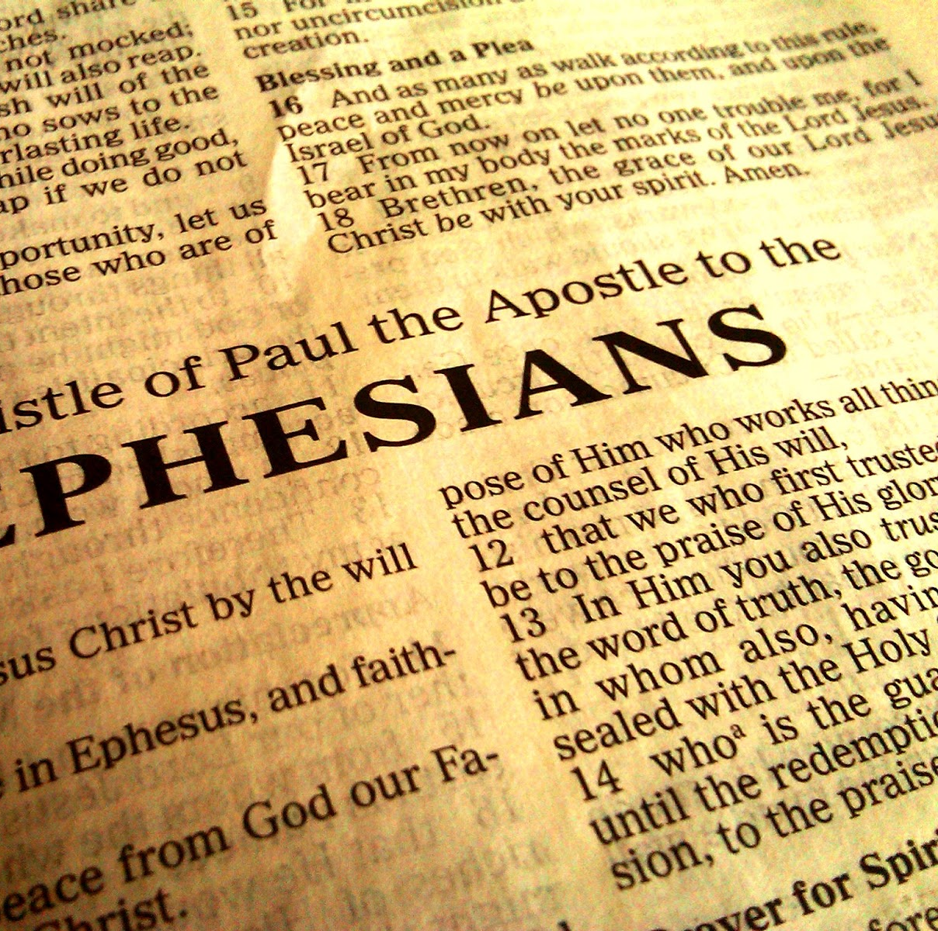
“Once you were dead because of your disobedience and your many sins.
You used to live in sin, just like the rest of the world, obeying the devil—the commander of the powers in the unseen world. He is the spirit at work in the hearts of those who refuse to obey God.
All of us used to live that way, following the passionate desires and inclinations of our sinful nature.”

Slide 5
^{36:26} And I will give you a new heart, and I will put a new spirit in you. I will take out your stony, stubborn heart and give you a tender, responsive heart. ²⁷ And I will put my Spirit in you so that you will follow my decrees and be careful to obey my regulations.

Slide 6
Why an atheist academic changed her mind on churches’ tax status
"I can share that we recently found religious charities—the vast majority of which are churches and/or christian organisations—contributed an enormous $6.1 billion to New Zealand in 2018 alone."
Unfortunately, because churches tend to go quietly about helping people in need, avoiding publicity or attention, there is little research into the value churches provide to NZ, and we don’t hear too many stories about the lives that are changed as a result.

