Slide 1
HOPE
Advent series
Week One

Slide 2
ADVENT: WAITING and HOPE
Those who learn to wait are uneasy about their way of life, but yet have seen a vision of greatness in the world of a future and are patiently expecting its fulfilment… (Dietrich Bonhoeffer)
Hope is the confident expectation of God’s ultimate blessing in this life and the life to come, based upon the goodness and promises of God. With Jesus, there is always hope

Slide 3
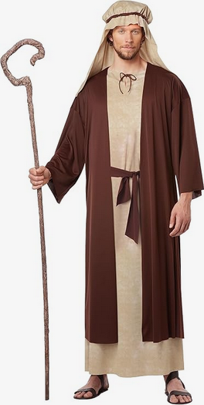
Mary and Cleopas

Slide 4
God’s decree
I will keep the promise I made to the families of Israel and Judah. . . God has made it clear there will always be a descendant of David ruling the people of Israel…
Jeremiah 33

Slide 5
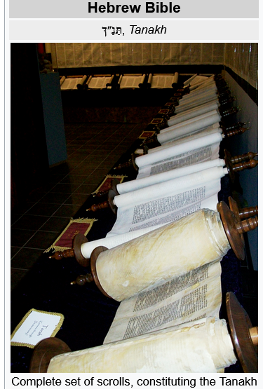

Slide 6
Where is our messiah?
c 598 – 587 BCE Taken in exile to Babylon
539 -332 Persian rule
538 Edict of Cyrus allows Jews to return to Jerusalem
Greek rule 333 – 166
Jewish revolt led by Judas Maccabeus 166 - Independence until 63 BCE
Roman rules via puppet kings

Slide 7
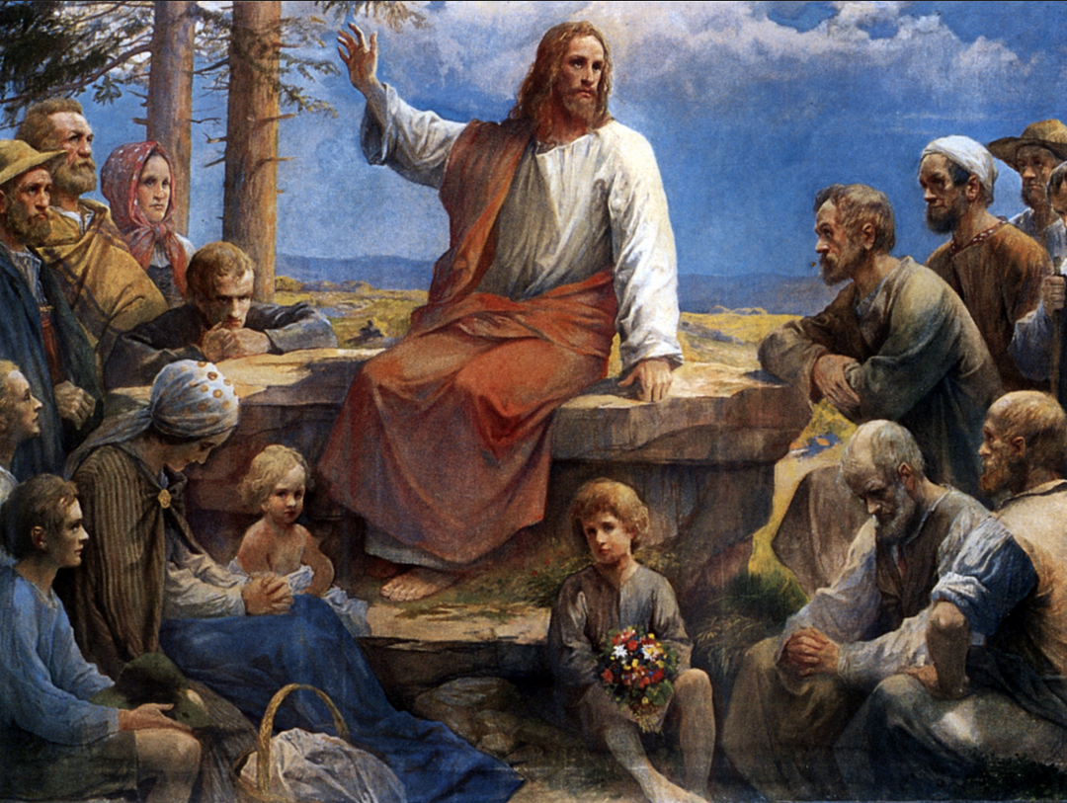
JESUS?

Slide 8
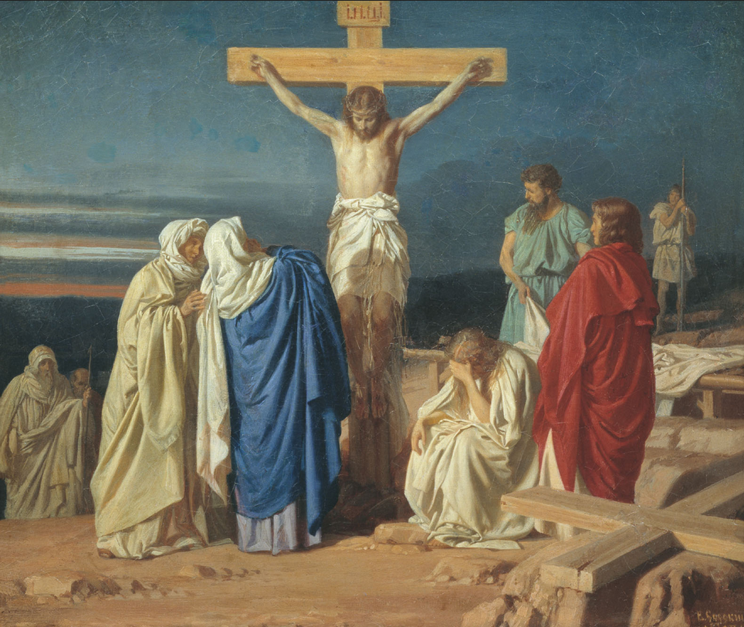
From hope to despair

Slide 9
A GLOOMY WAY HOME

Slide 10
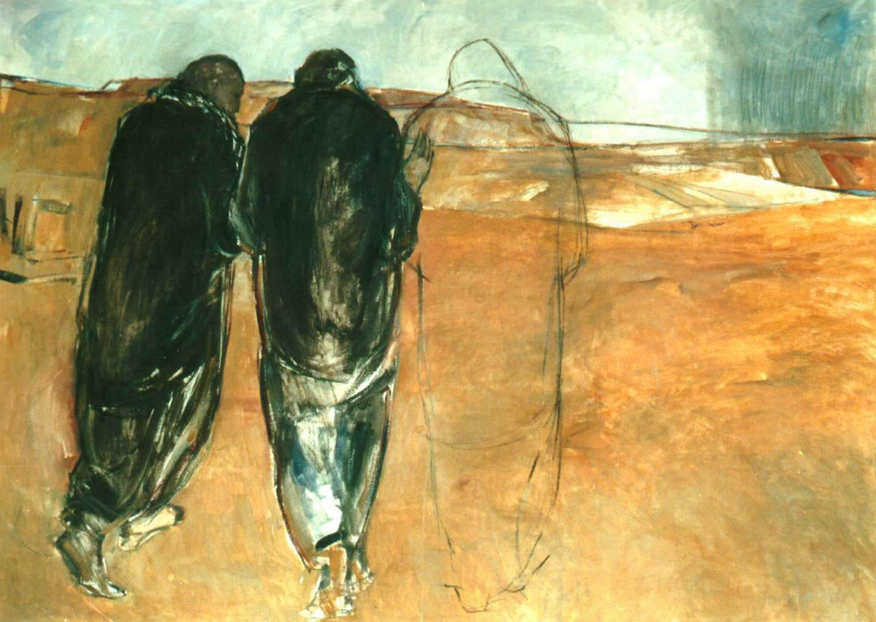
A mysterious stranger

Slide 11
What has changed?
Something has gripped their hearts that made them look at things differently
God’s ways are not like ours
God knows us and cares for us

Slide 12
I pray that your hearts will be flooded with light so that you can understand the confident hope he has given to those he called—his holy people who are his rich and glorious inheritance.
Ephesians 1:18
Hope is a strong and trustworthy anchor for our souls. Hebrews 6:19

Slide 13
Hold
On to the
Promises of
Emmanuel (God With Us)

