Slide 2
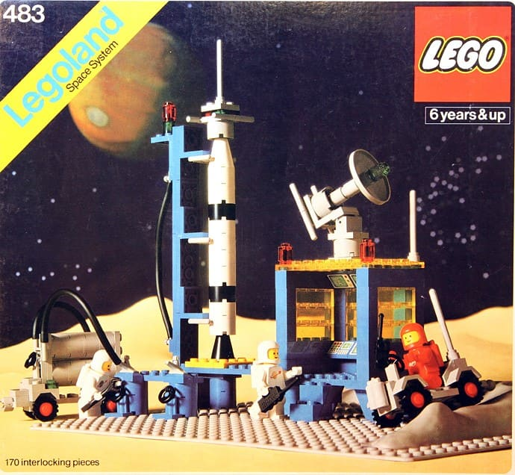
Some assembly required

Slide 5
Acts 2:1-4 When the day of Pentecost arrived, they were all together in one place. And suddenly there came from heaven a sound like a mighty rushing wind, and it filled the entire house where they were sitting. And divided tongues as of fire appeared to them and rested on each one of them. And they were all filled with the Holy Spirit and began to speak in other tongues as the Spirit gave them utterance.

Slide 6
Psalm 133
¹⁻³ How wonderful, how beautiful, when brothers and sisters get along! It’s like costly anointing oil flowing down head and beard, Flowing down Aaron’s beard, flowing down the collar of his priestly robes. It’s like the dew on Mount Hermon flowing down the slopes of Zion. Yes, that’s where God commands the blessing, ordains eternal life.

