Slide 1
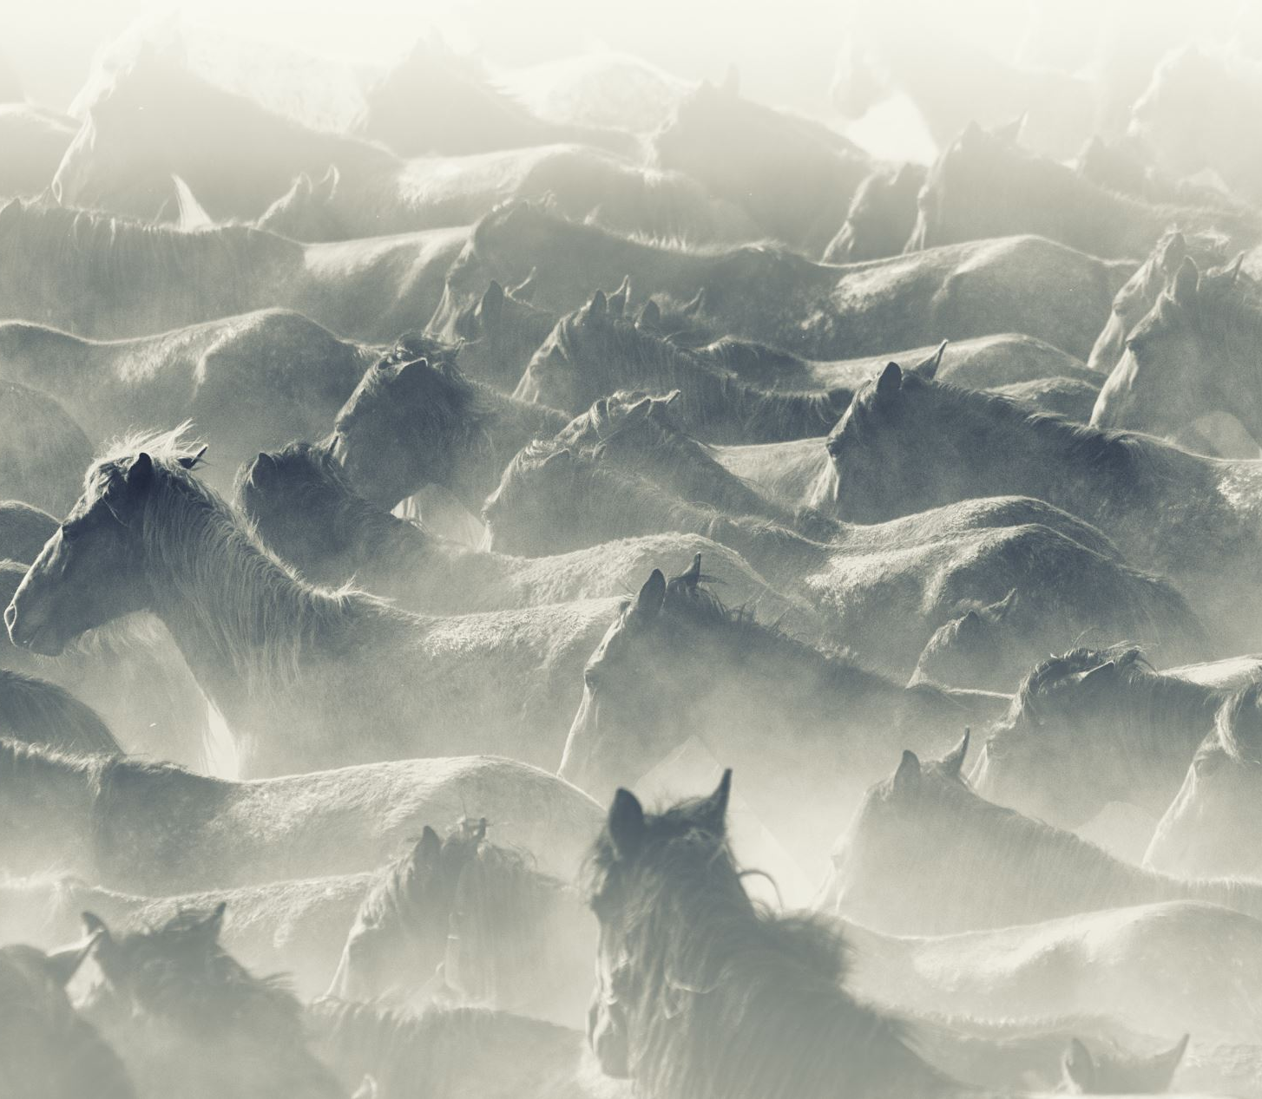
Exodus 32
It's no sitcom

Slide 2


Slide 3


Slide 4
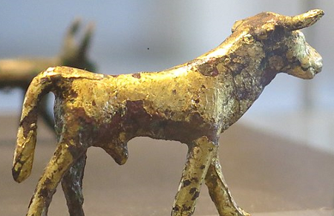

Slide 5
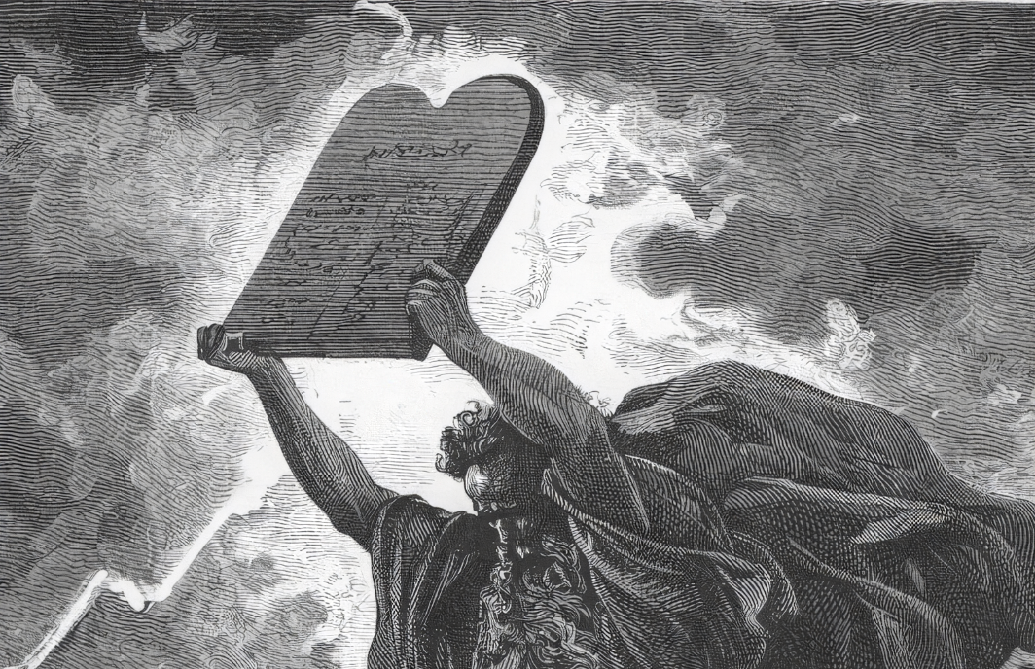

Slide 6


