Slide 1
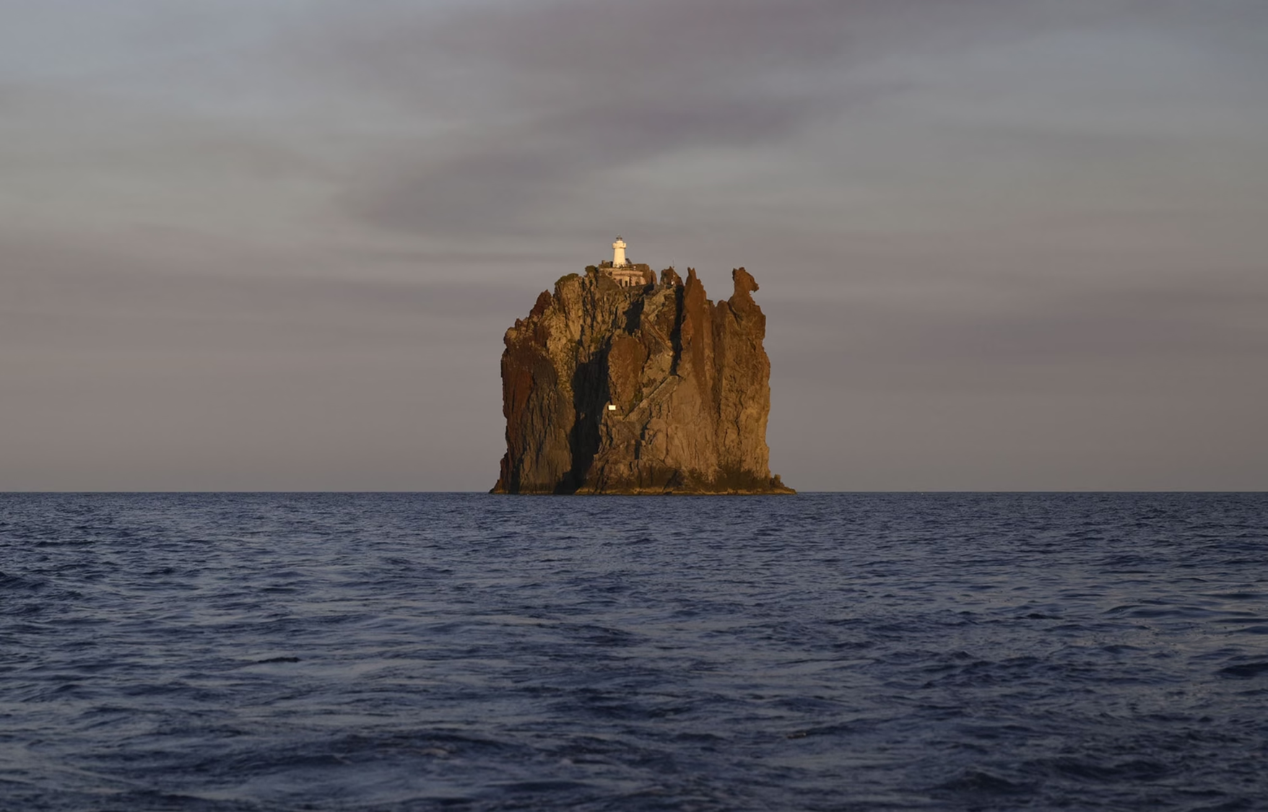
Parables 2

Slide 2
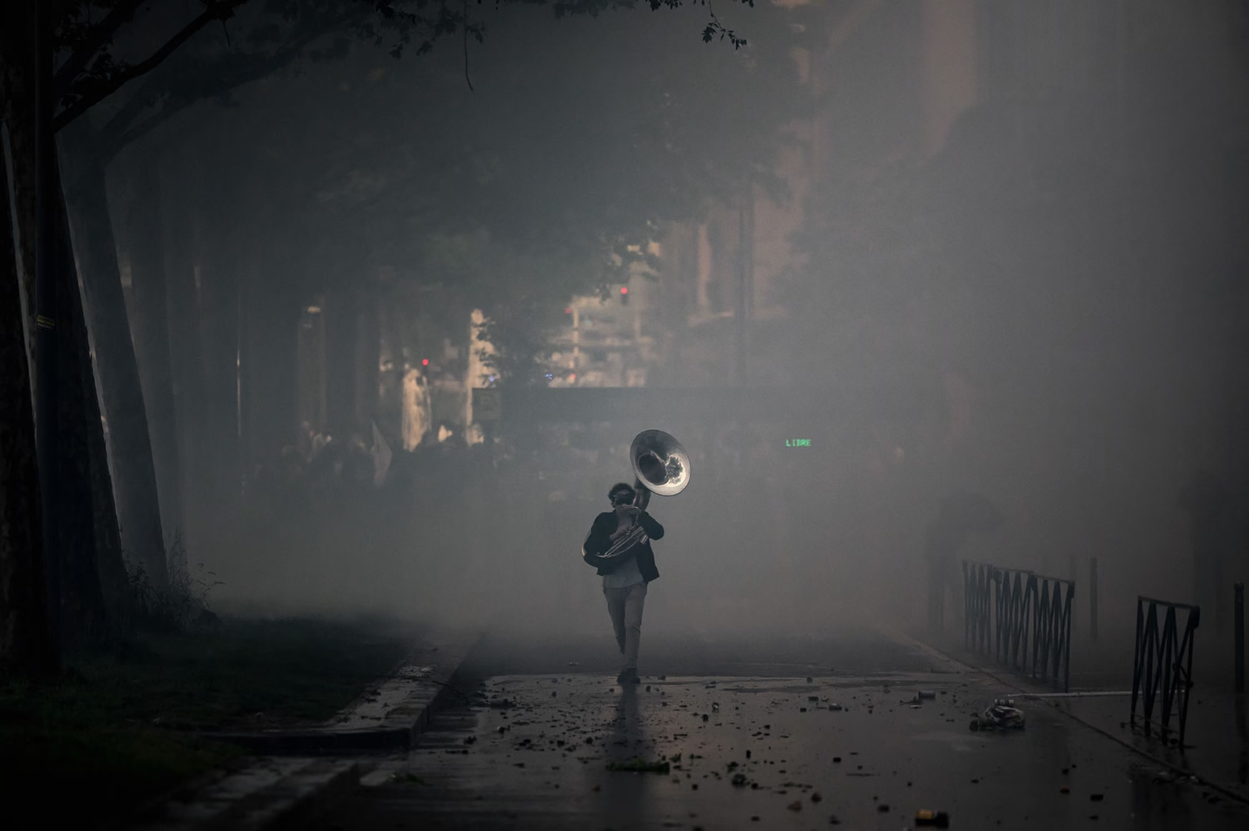
The Treasure and the Pearl

Slide 3
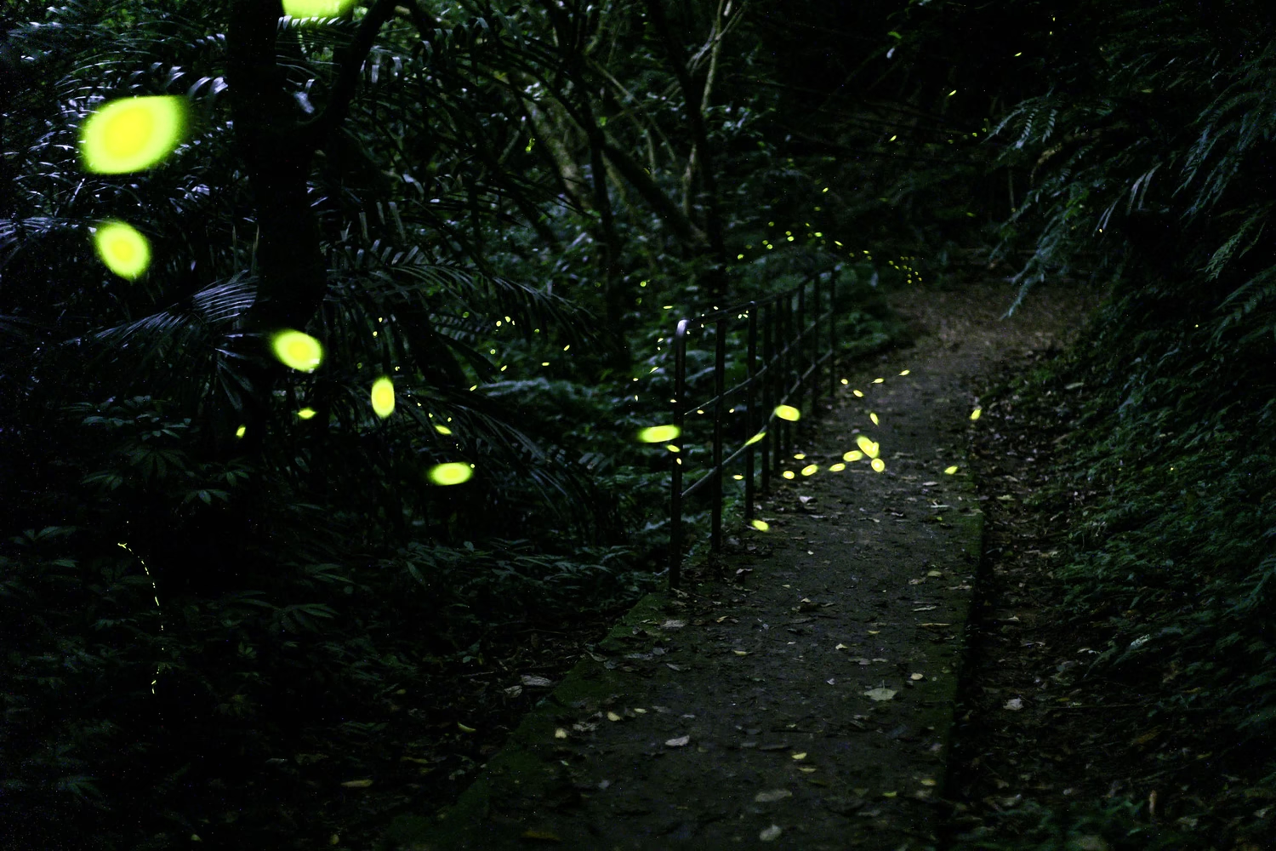
Midway upon the journey of our life
I found myself within a forest dark
For the straightforward pathway had been lost
Dante

Slide 4
Since there are robberies outside and inside the city gates

Slide 5
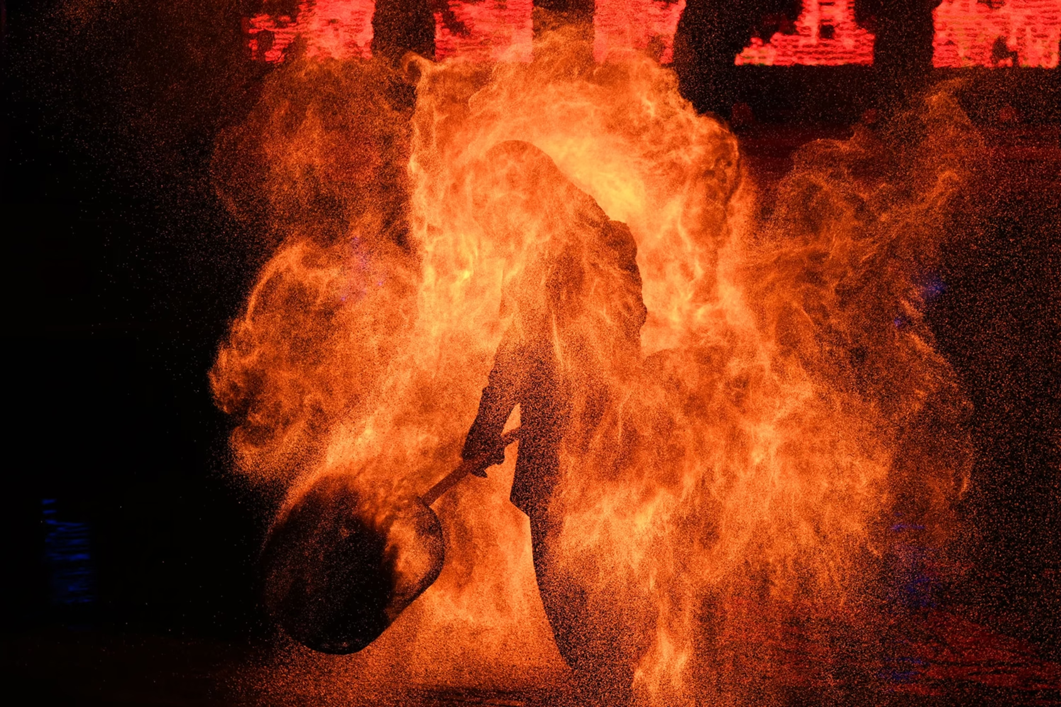
David
(2 Sam 12)

Slide 6
The Shrewd Manager
(Luke 16:1-10)

Slide 7
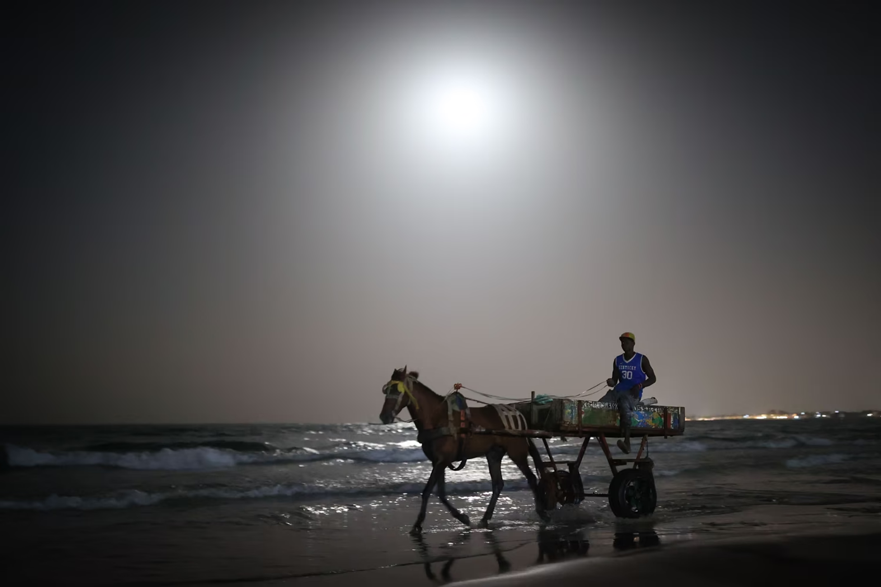
Philip
(Acts 8)

