Slide 1
Exodus part 3
Chapters 5 and 6.

Slide 2
Word

Slide 3
Work

Slide 4
Work: can't live with it

Slide 5
Work:
can't live with it
can't live without it

Slide 6
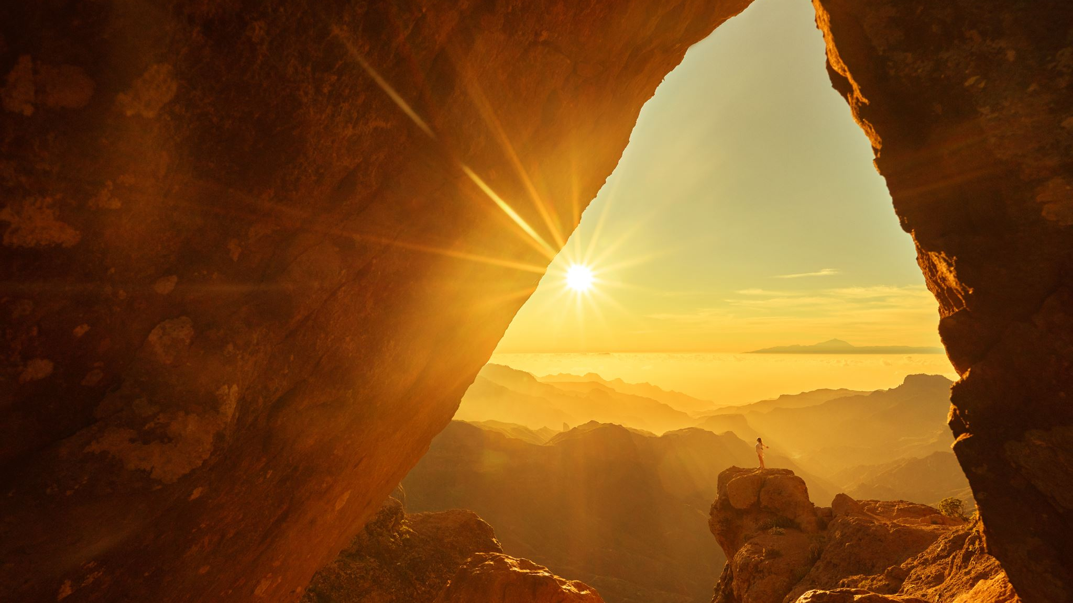
God's Three-part salvation plan
Force Pharaoh to free the Hebrews
Take a three-day wilderness journey to worship God
Inherit the Promised Land

Slide 7
Word

Slide 8
Worship

Slide 9
The first holiday?

Slide 10
Day seven of creation:
the first holy day

Slide 11
We need recreation

Slide 12
We need God's word of re-creation

