Slide 2
What do you get out of church?

Slide 3
What do you put into church?

Slide 4
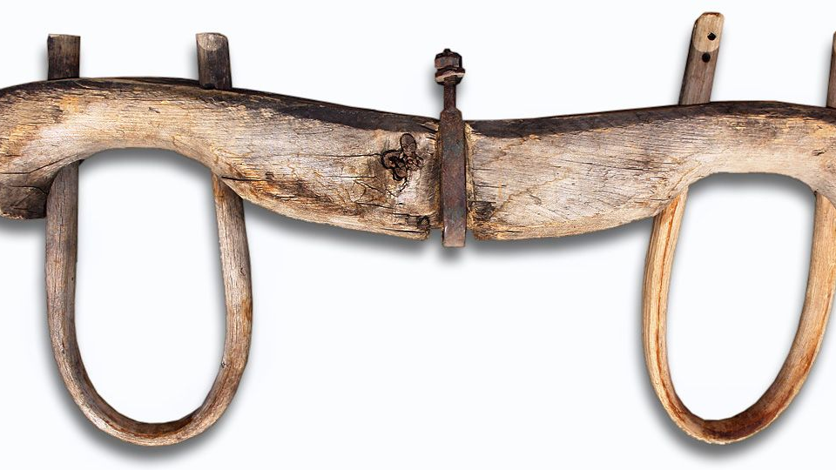
One Vision one goal one end-game

Slide 5
Take your pick
1. Membership
2. Fellowship
3. Citizenship
4. Ownership

Slide 6
Eldership indicators
Demonstrates an active personal life of prayer and Bible reading (includes leading a devotional to open elders' meetings on a rostered basis, leading communion as required, and offering Biblical insights to eldership issues).
Attend 75% of official church gatherings (includes extra church events i.e Easter, Matariki, Christmas events) and 90% of eldership meetings.
Knows our ministry leaders: their ministry vision, and their walk with Jesus.
Listens to 90% of church sermons and contributes to eldership conversations about future teaching needs.
Active and contributing member of a life group
Actively mentoring / discipling someone, i.e regular intentional conversations about their gifts, what is their next step with Jesus, struggles and tensions, questions, hopes and aspirations.
Promotes our Values and their purpose, and upholds our Statement of Faith.
Maintains a good reputation with people within and outside the church. People in general speak well of you.

Slide 7
Membership indicators?
Demonstrates an active personal life of prayer and Bible reading
Shows up (% attendance?)
Builds unity across the church
Active and contributing member of a life group
Being discipled
Discipling someone
Uses their gifts in ministry or is actively seeking to
Knows our Values and their purpose, and upholds our Statement of Faith

